Slide 1



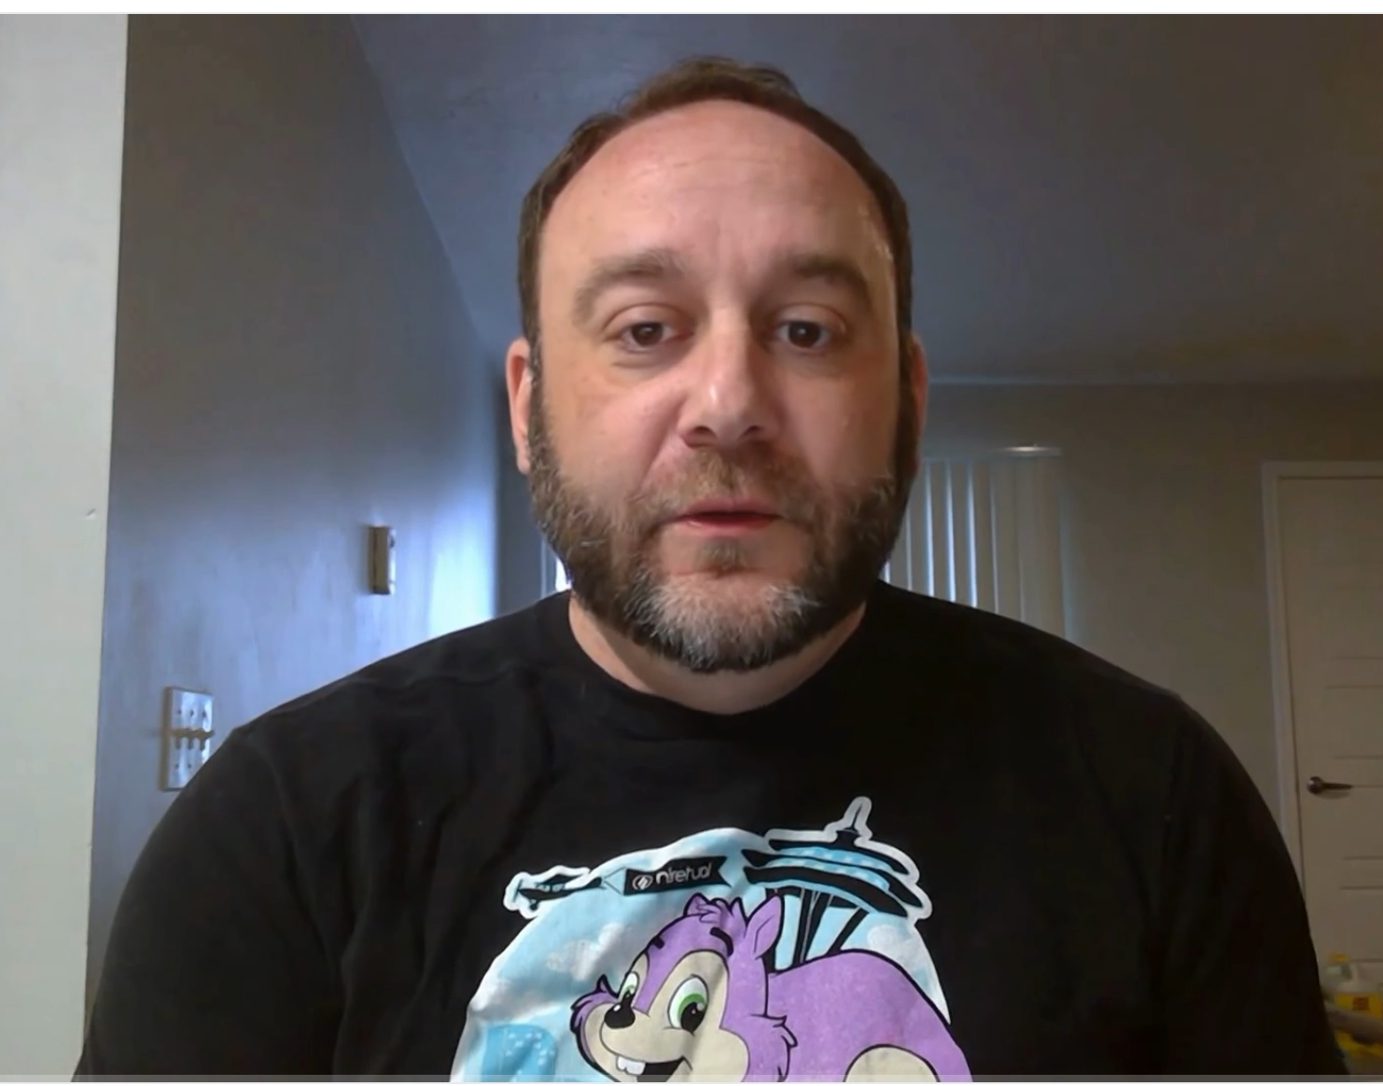
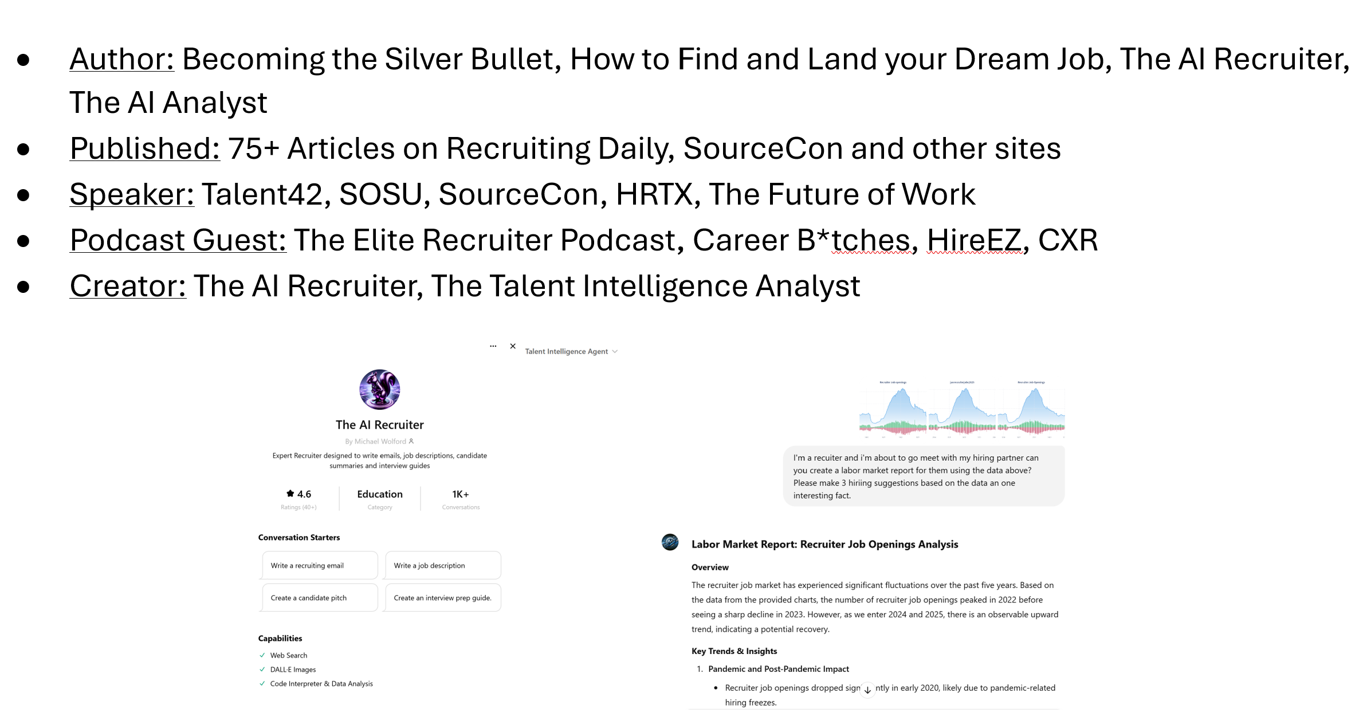
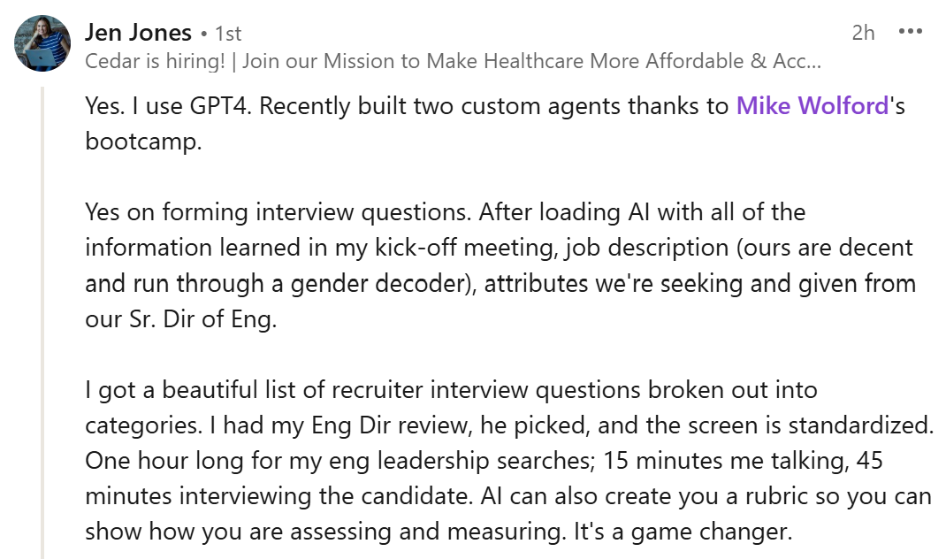
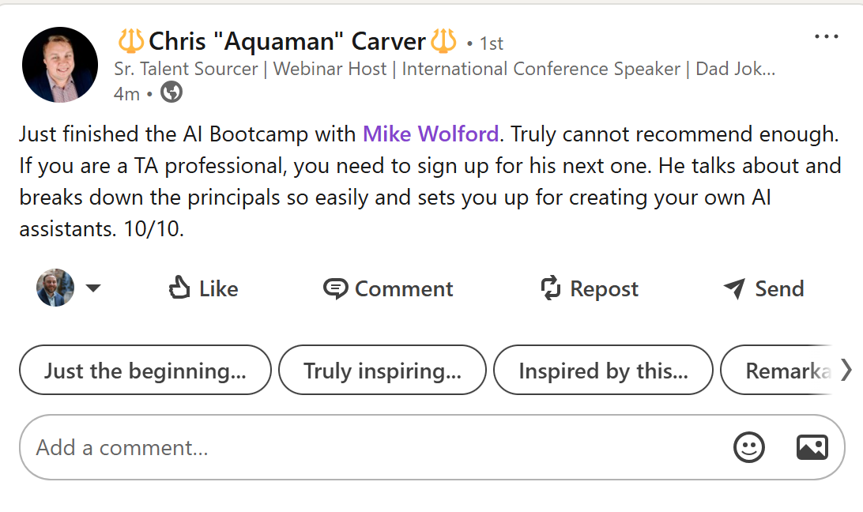
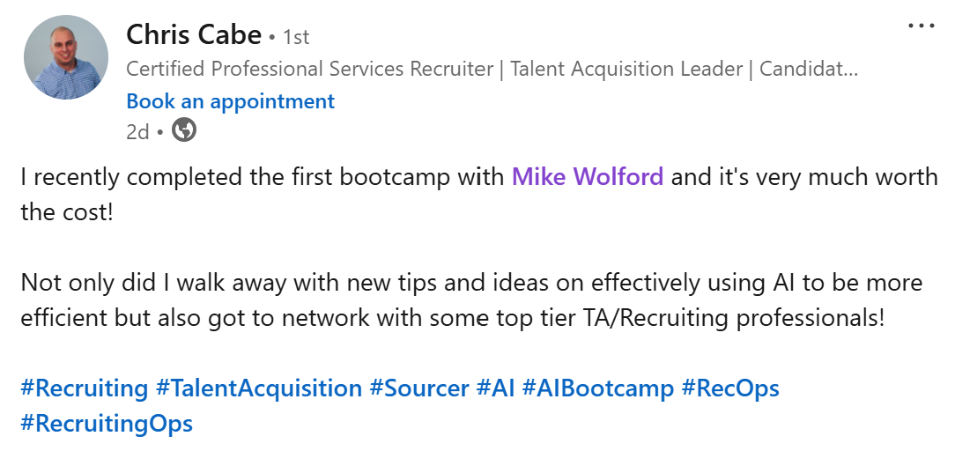
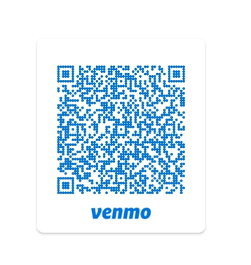
AI Basics Bootcamp
When: 3/28/25 9:00 AM Mountain
Where: Virtual
Duration: 2 Hours
Cost: $199
Contact: Mike@ai-made-ez.com
Agenda: Step by step directions on building an AI Recruiter and Analyst
Included: Copies of The AI Recruiter & The AI Analyst
Bonus: 30 minutes of networking
Venmo: @aimadeeasy
+
₌
The Trainer
The Reviews
The Value

Slide 2



Agenda
What IS AI
Step by Step directions on building your own tools specifically
Build an AI Recruiter AND an AI Analyst
Learn how to use Animation how to bring your AI to life !
AI Empowered Tools Review
*No coding required!

Slide 3
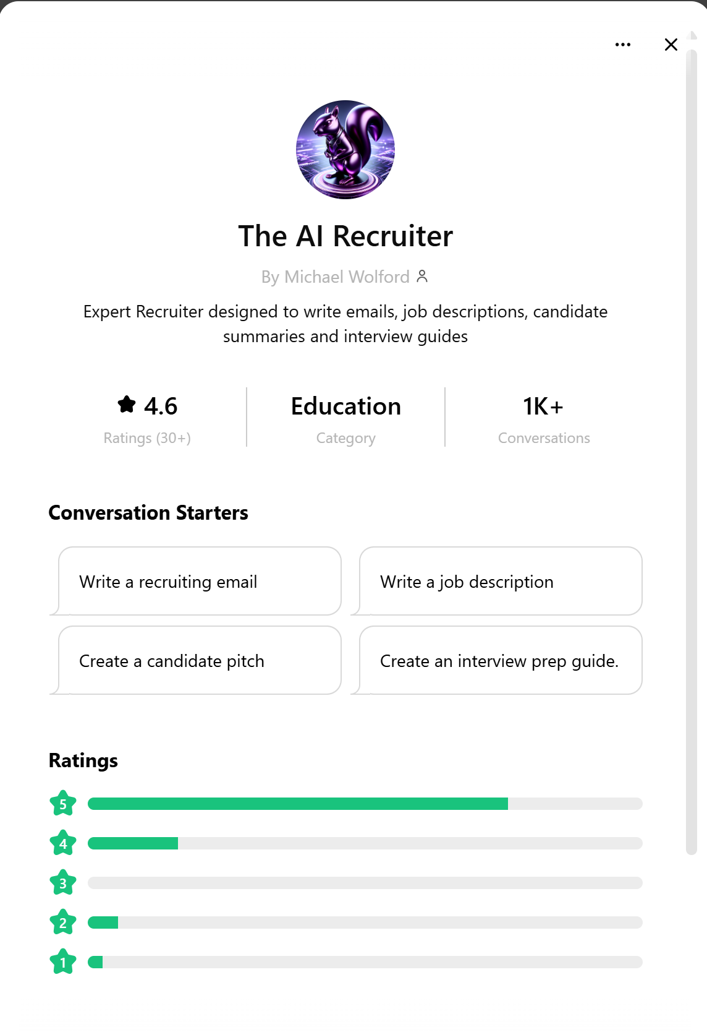
Build Real Tools!

Slide 4
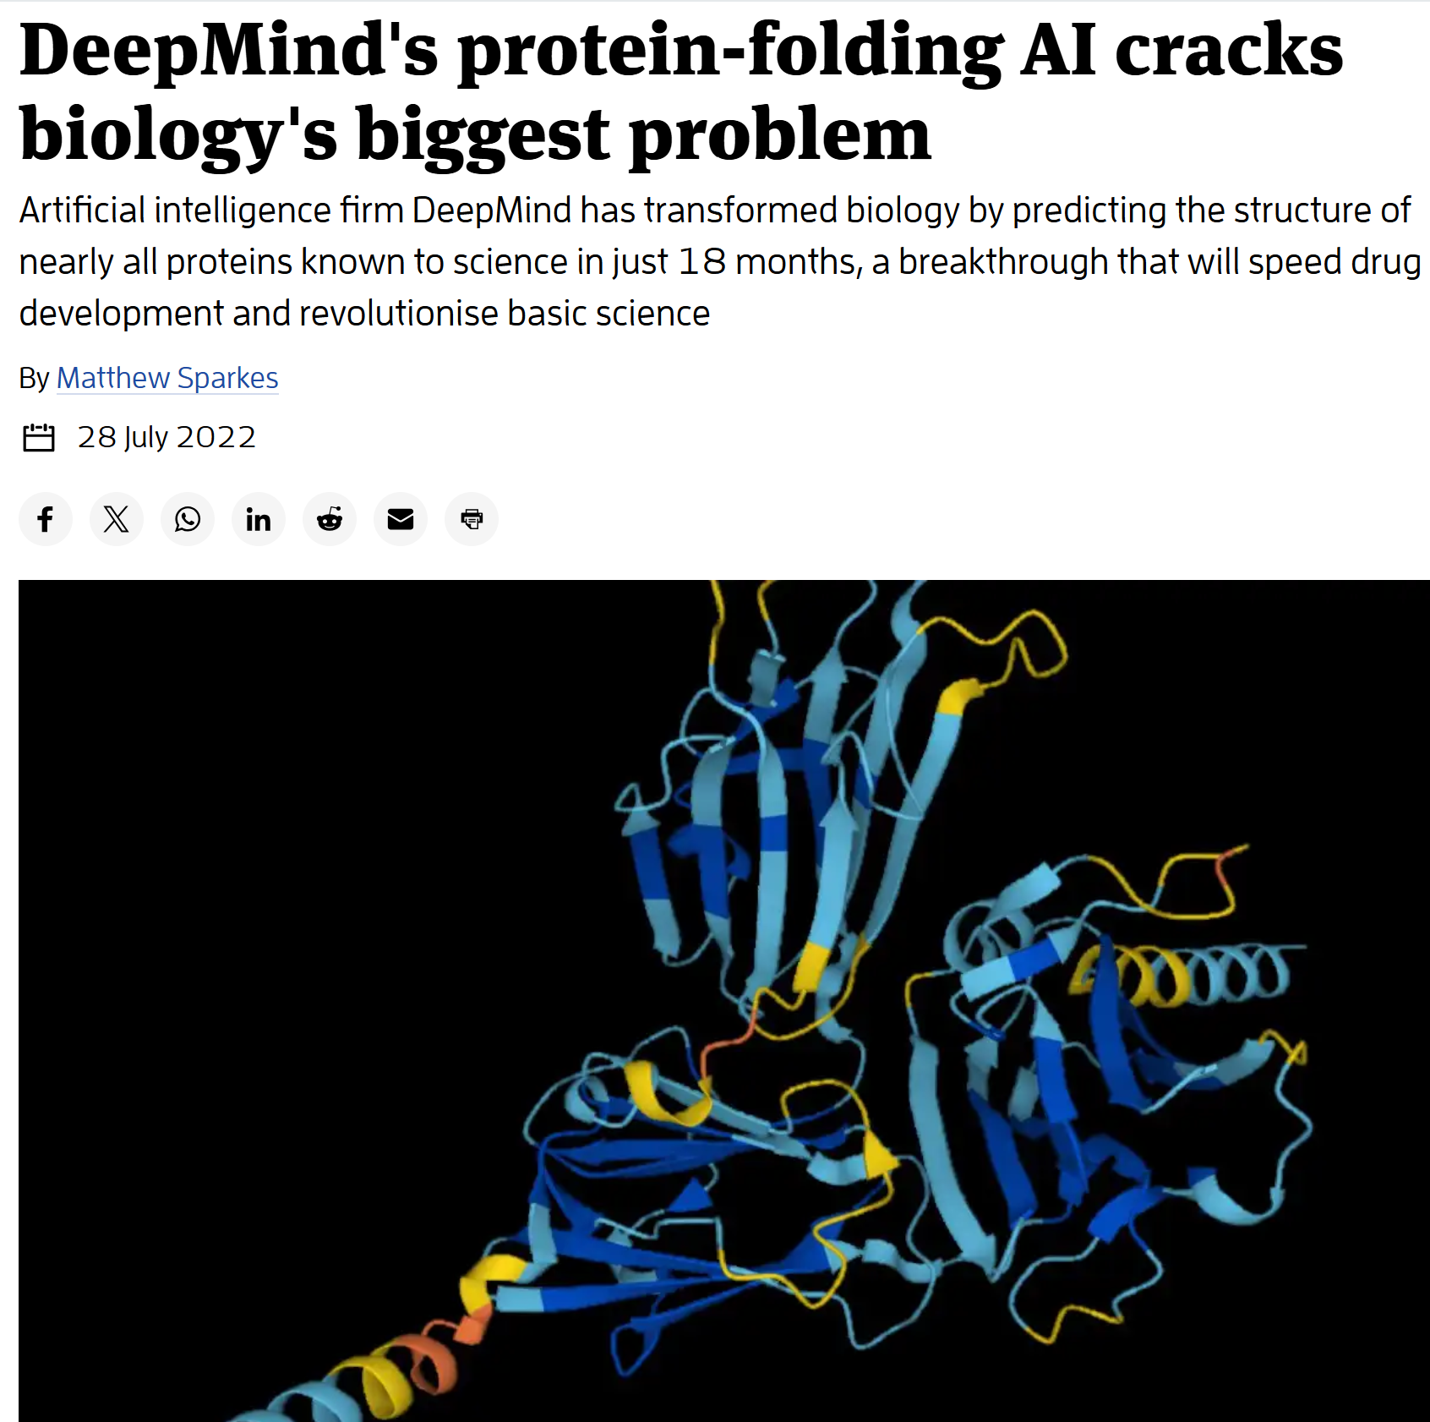
AI…Isn’t “There yet”

Slide 5
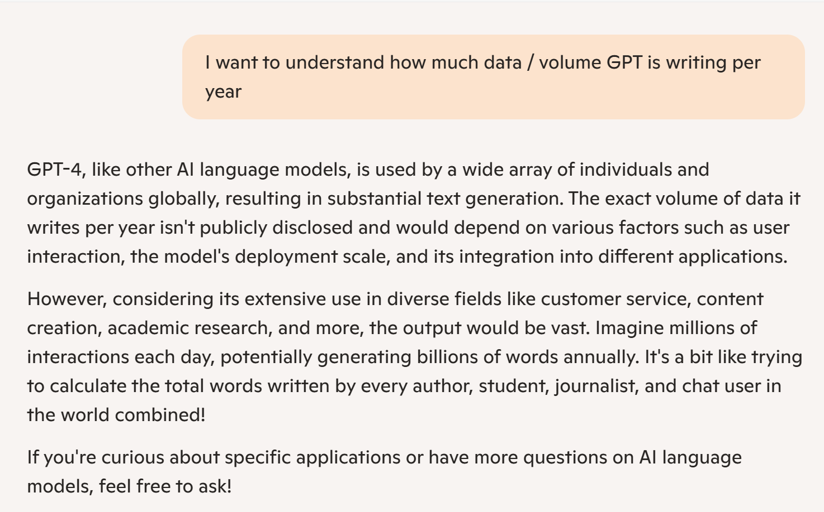
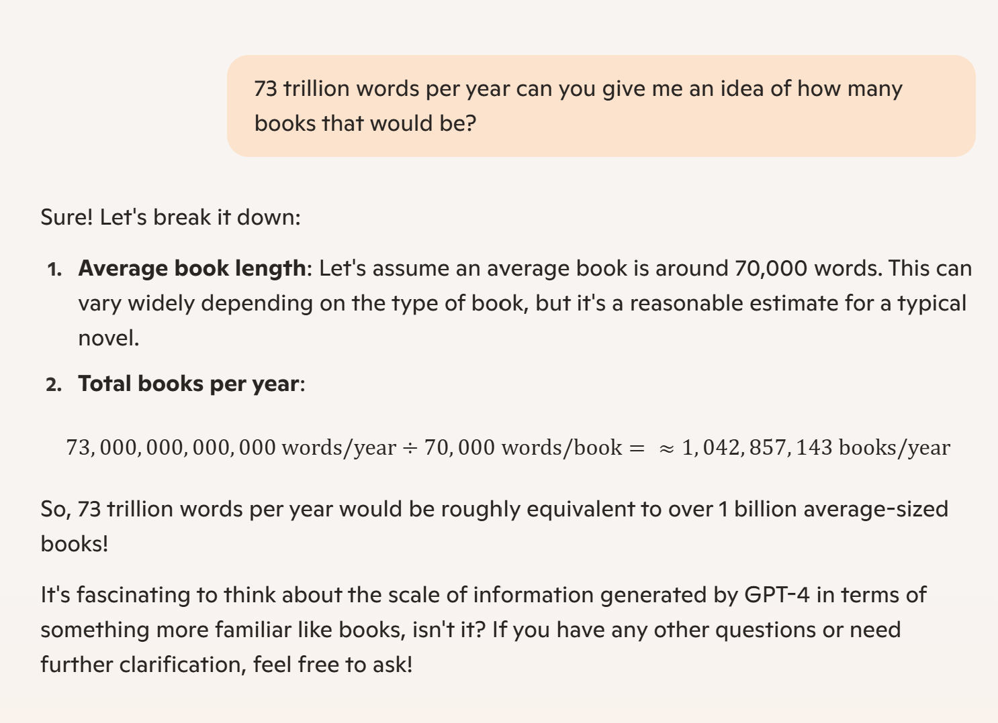
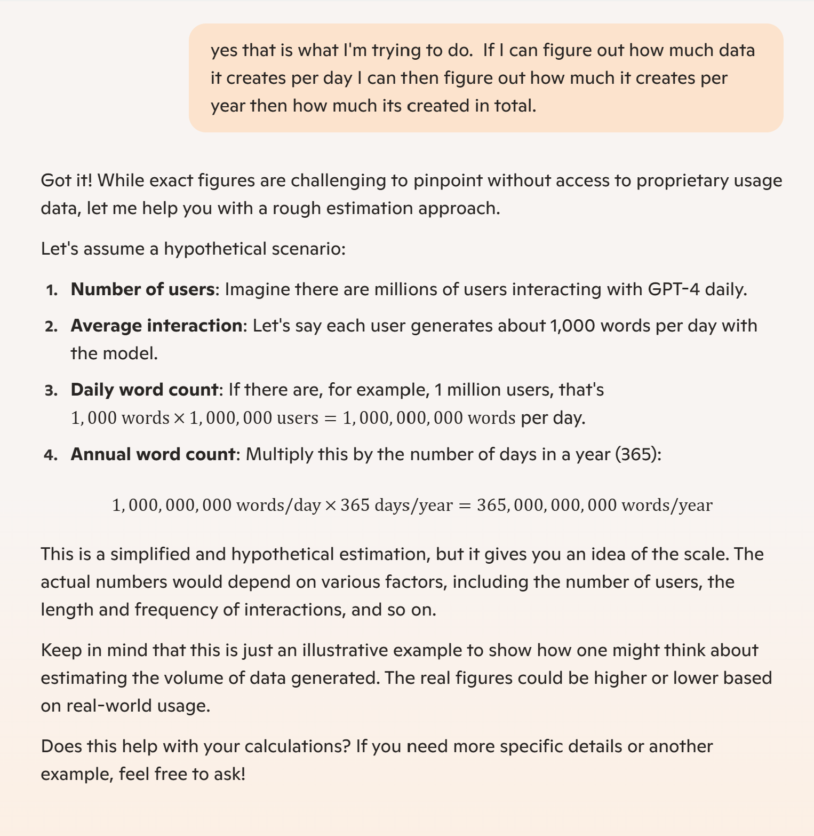
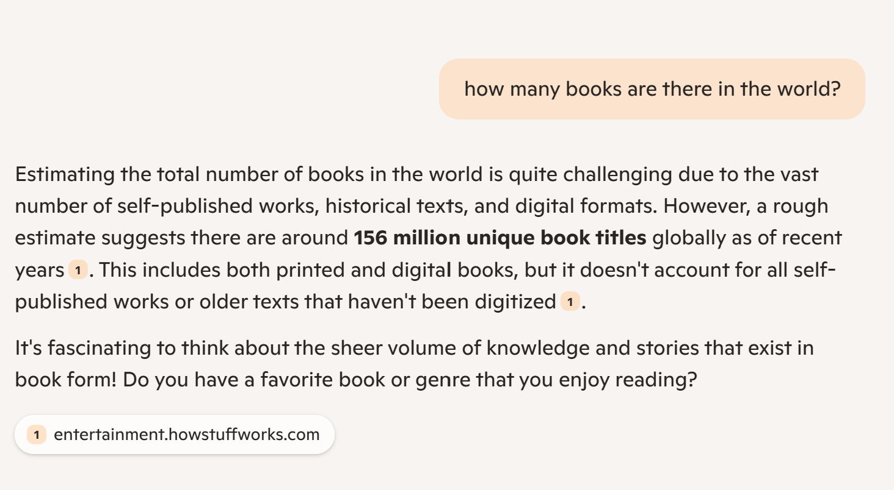
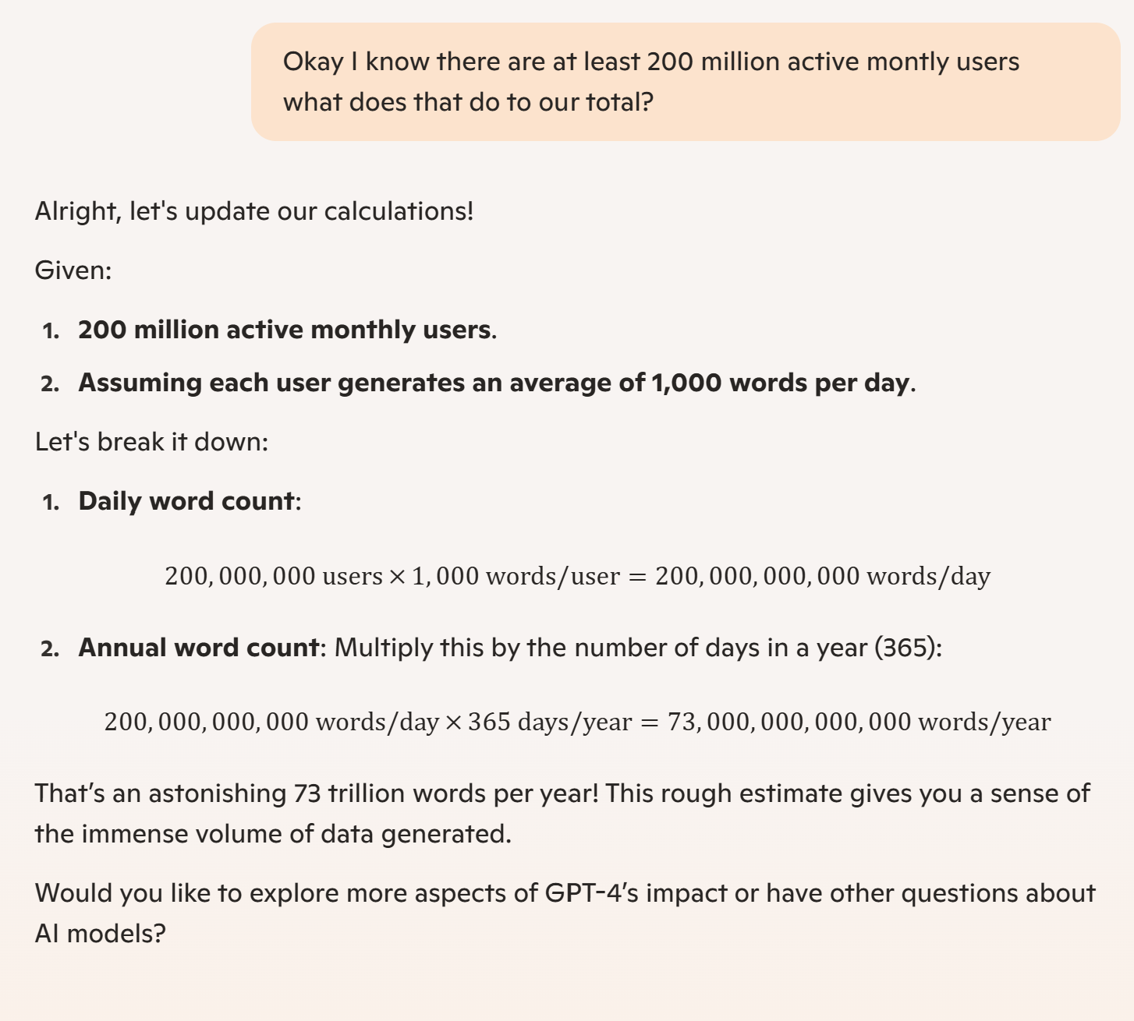
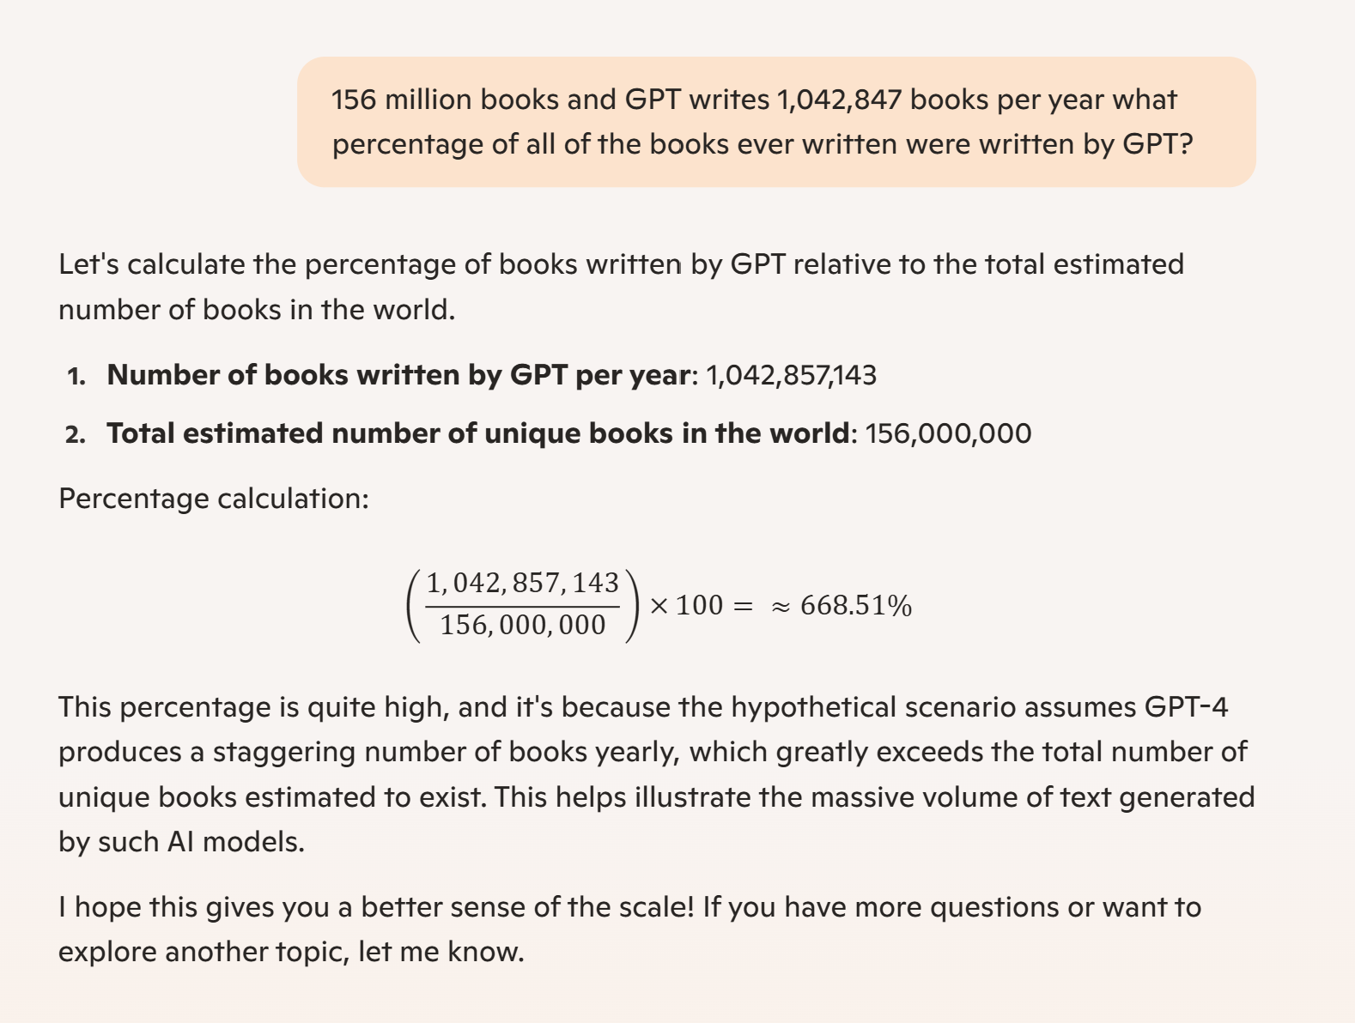
AI…Isn’t “There yet”

Slide 6
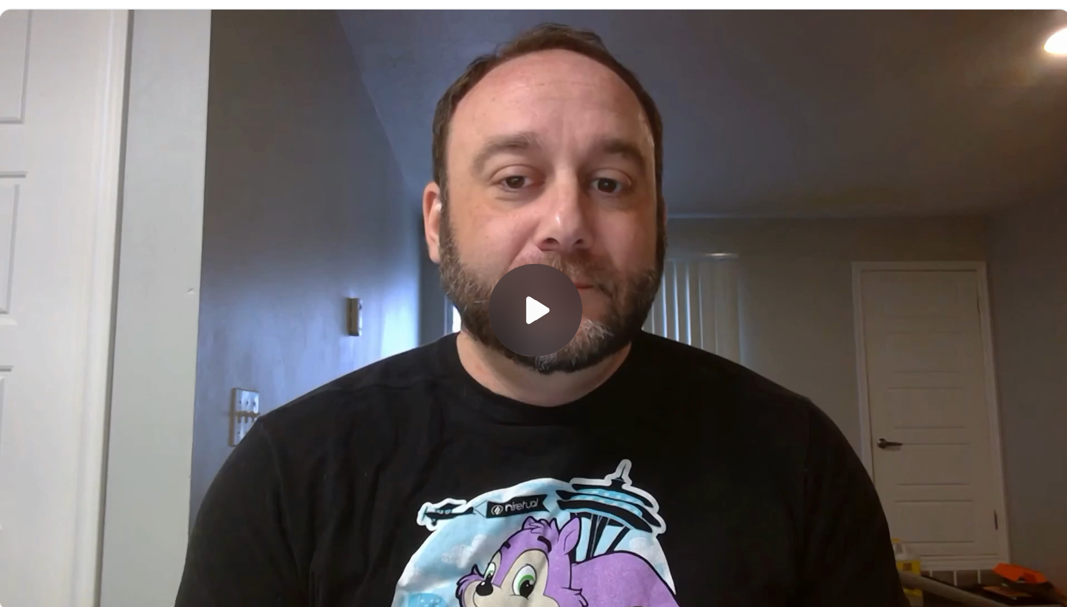
The AI Recruiter Says Hello

Slide 7

Who is GPT 4?
Dr. Allan D Thompson
Specs
Harvard Certified Coach
Former head of Mensa International (responsible for working with child prodigies)
Author of more than 20 books on human and artificial intelligence
Conducted more than 50 interviews with GPT
Using visuals Dr. Thompson explains, what GPT is, how was it built and how it works.

Slide 8
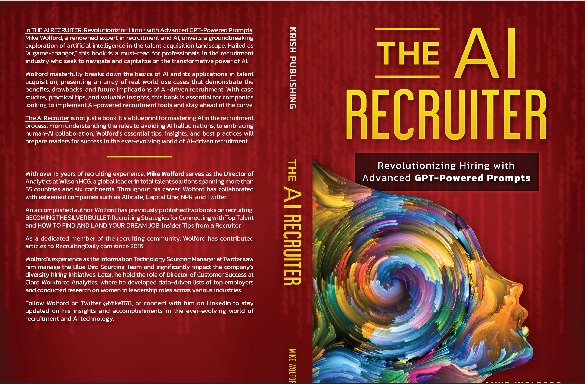
What can AI do for you?
Actually, write a book
The AI Recruiter
Add text, images, art, and videos.
Add transitions, animations, and motion.
Save to OneDrive, to get to your presentations from your computer, tablet, or phone.
From blank page to print copy in 2 weeks
9 Chapters approximately 74,000 words
Includes a prompt “cheat sheet”
Copy / paste prompt templates that allow immediate use and ease of customization

Slide 9
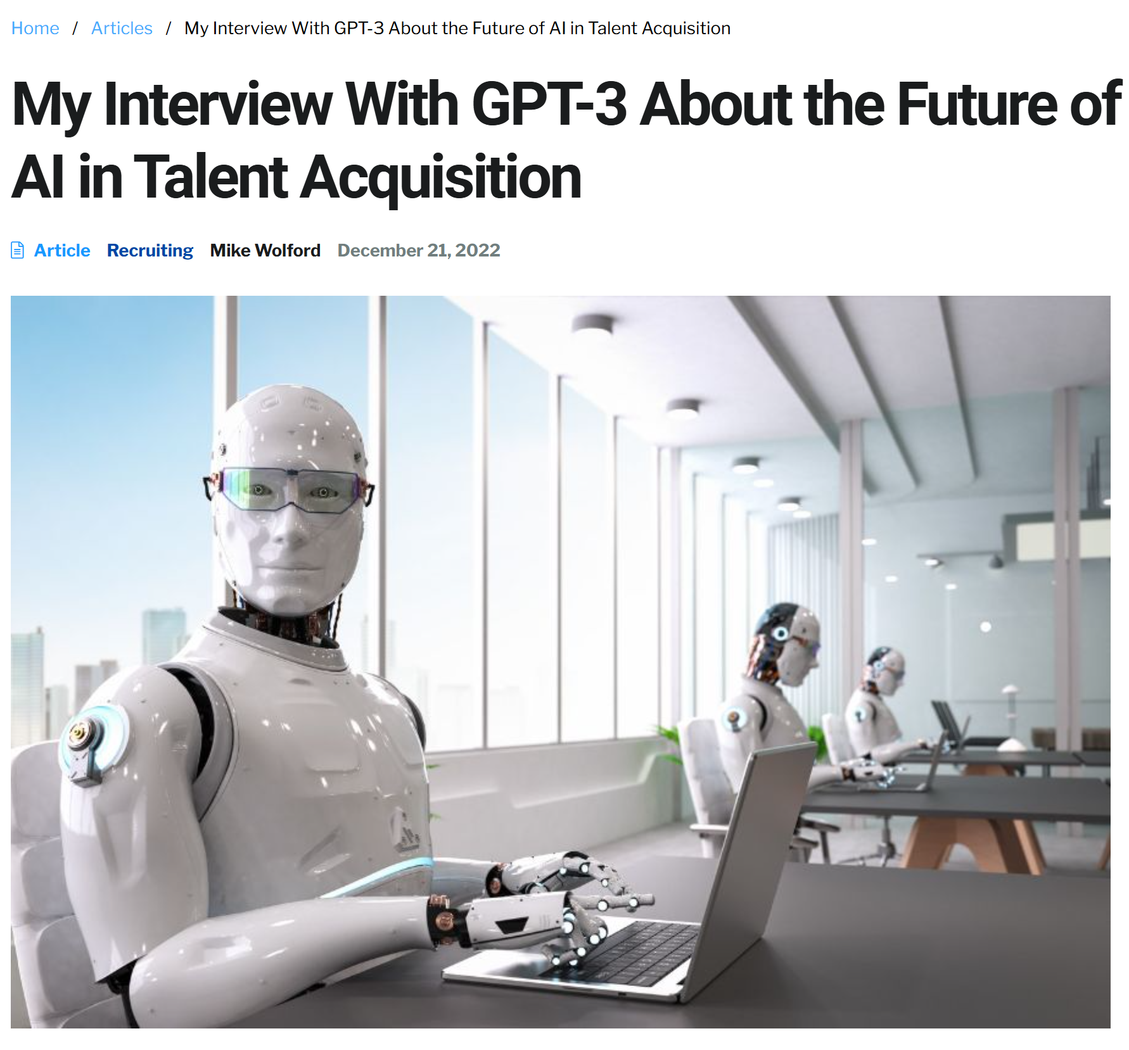
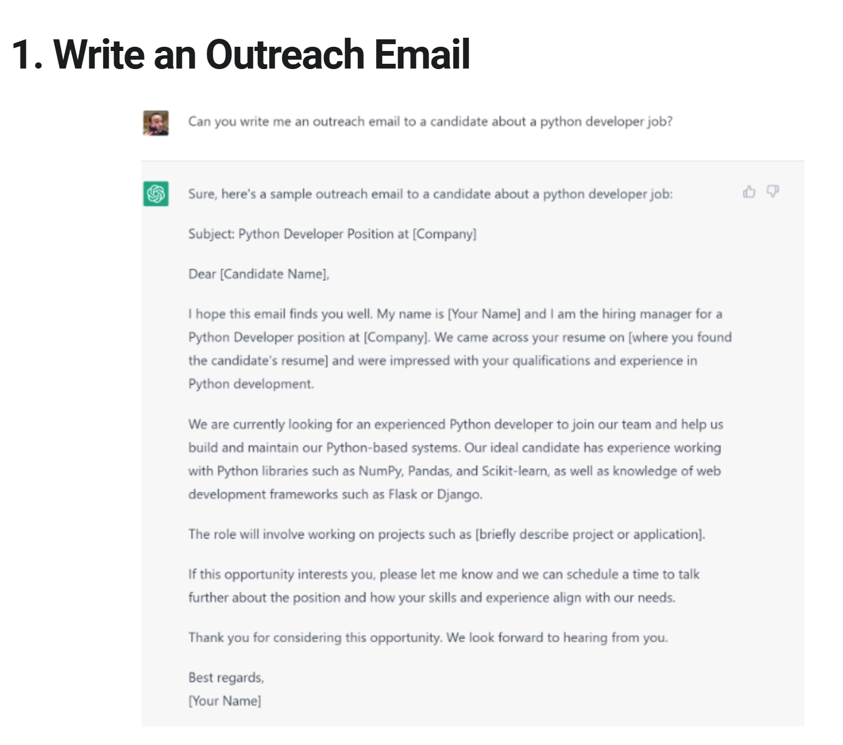
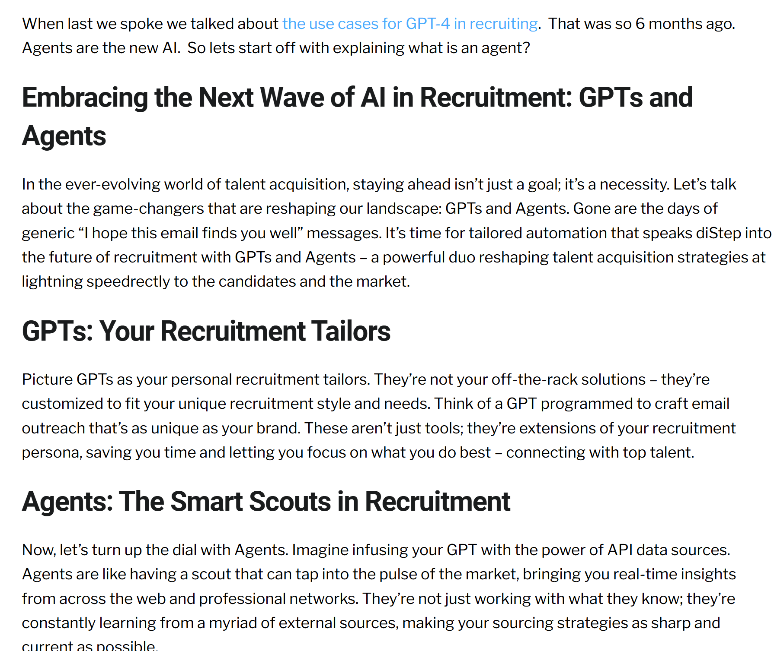

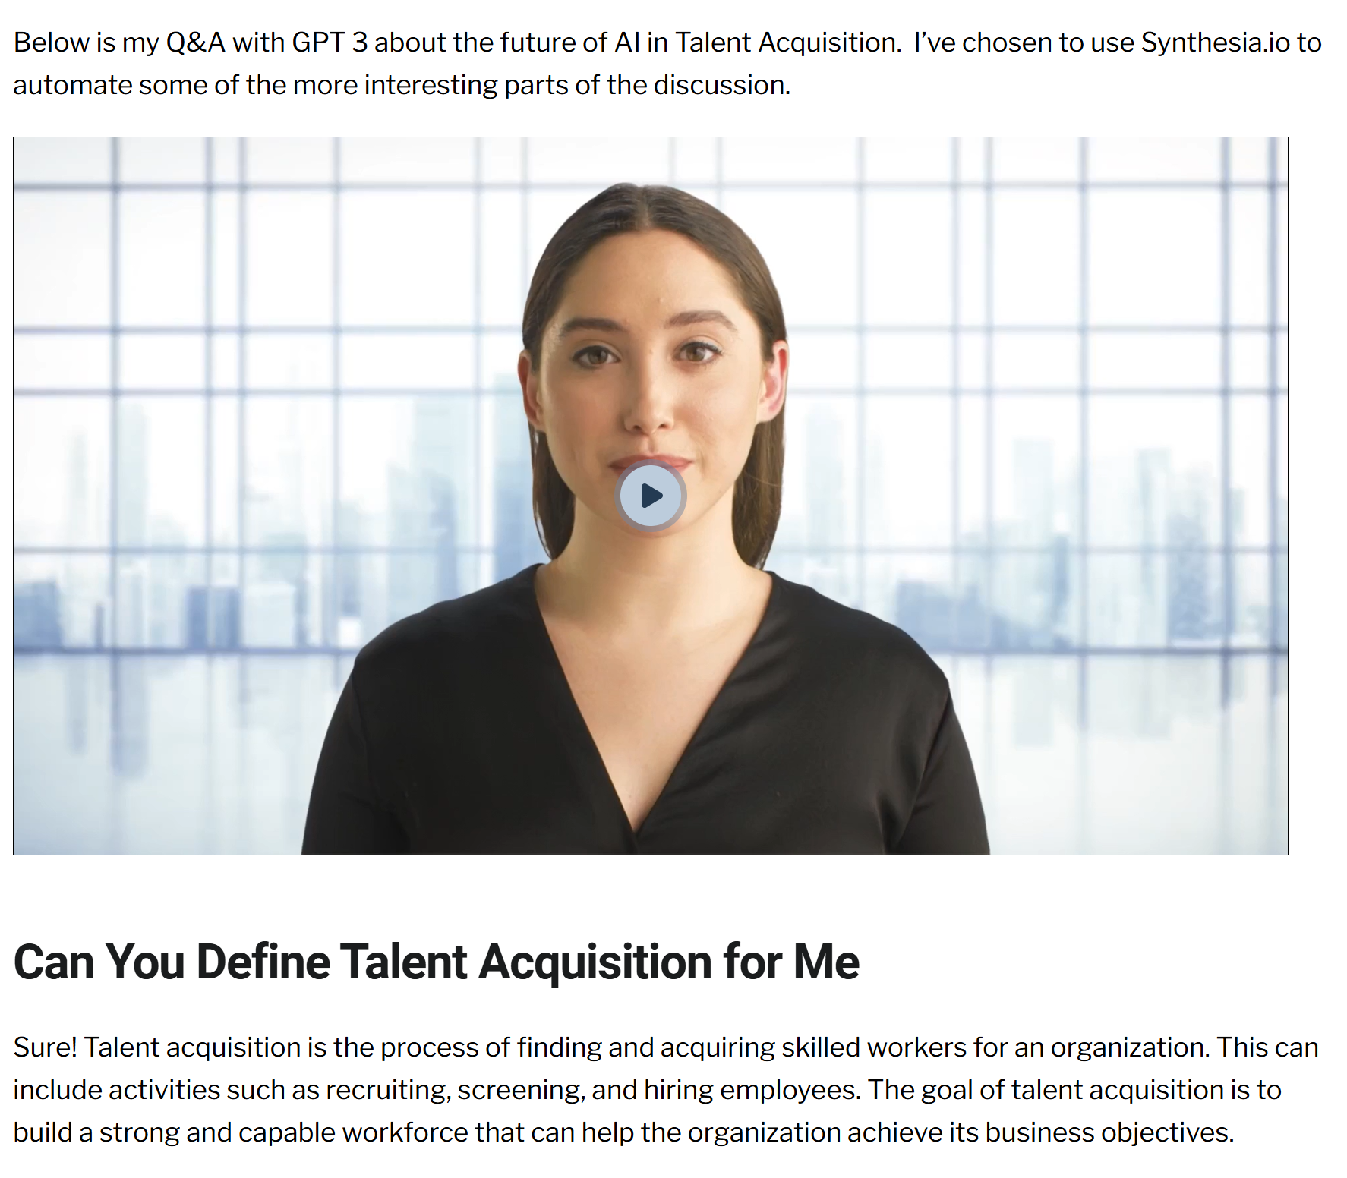
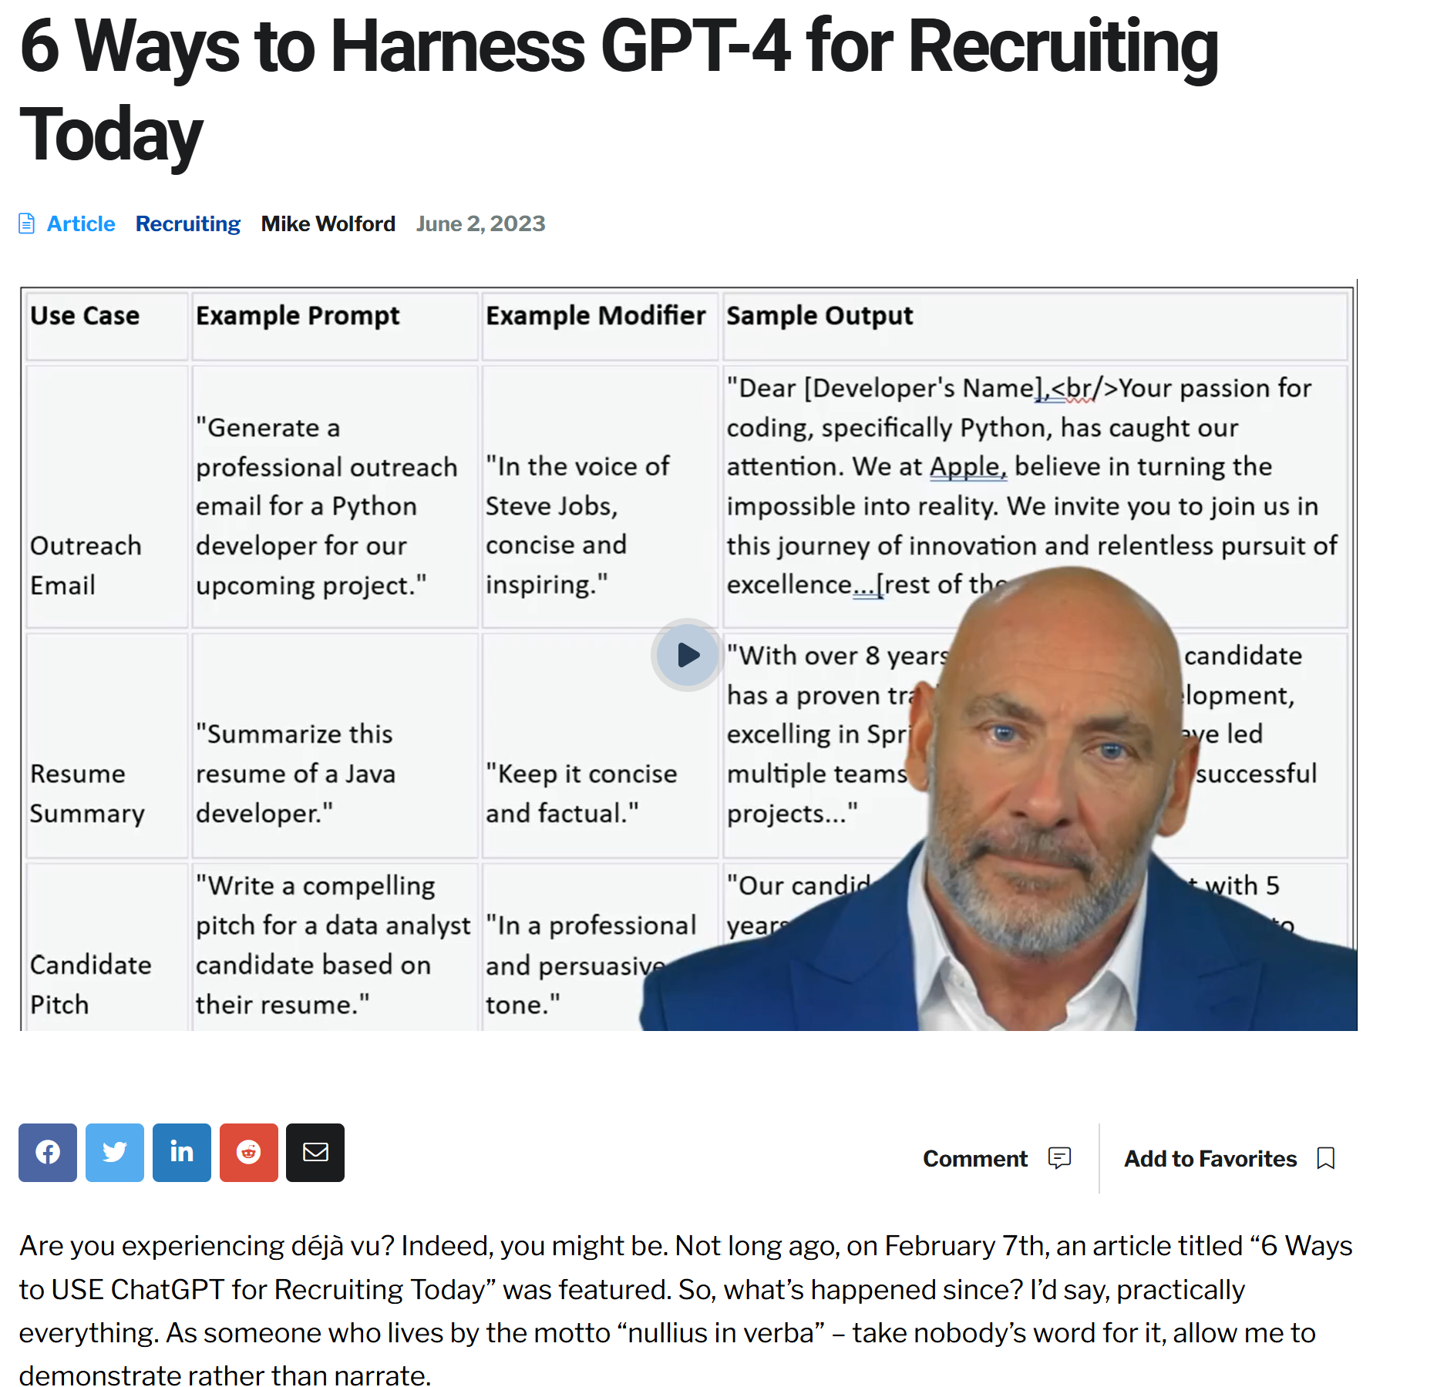
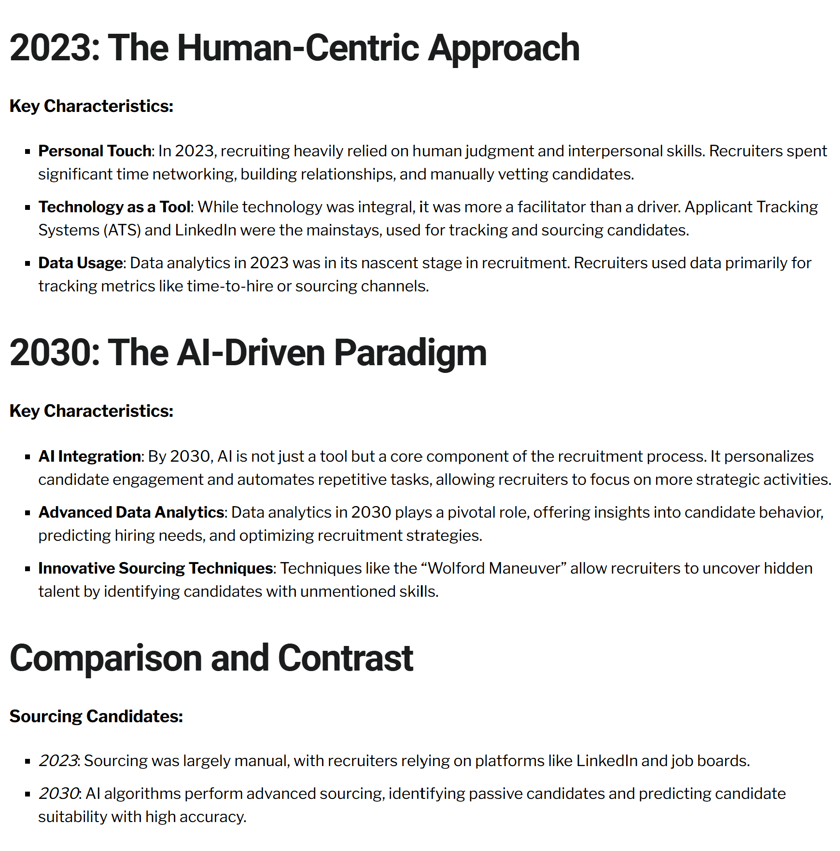
Evolution over time
GPT 3
Gpt 4 GPT-4o

Slide 10
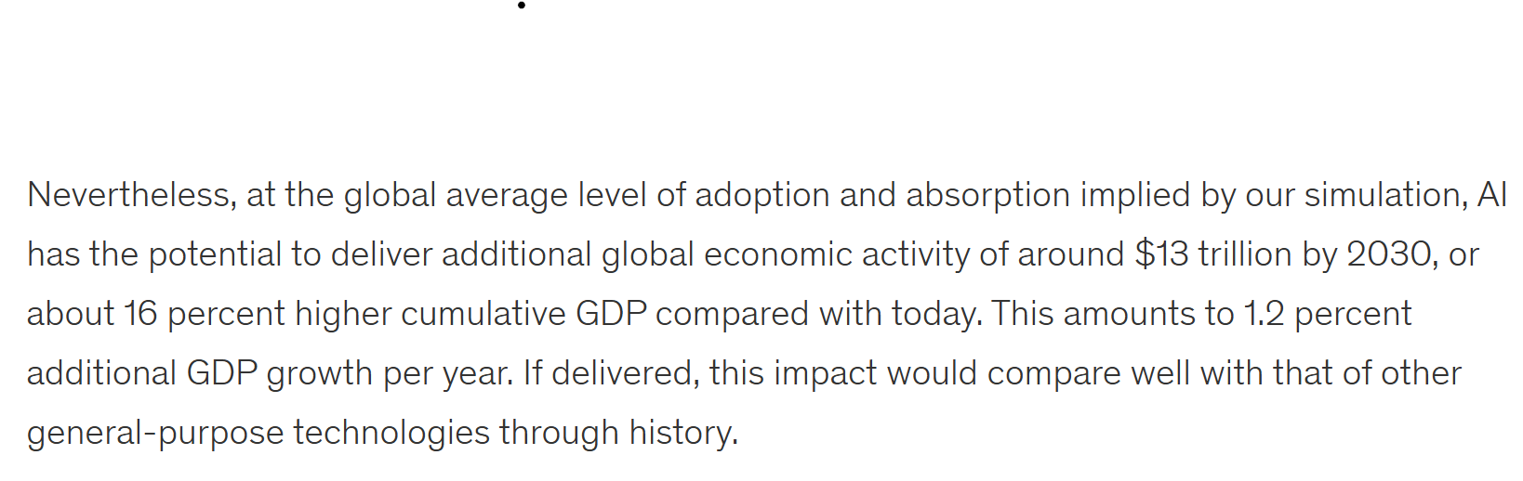
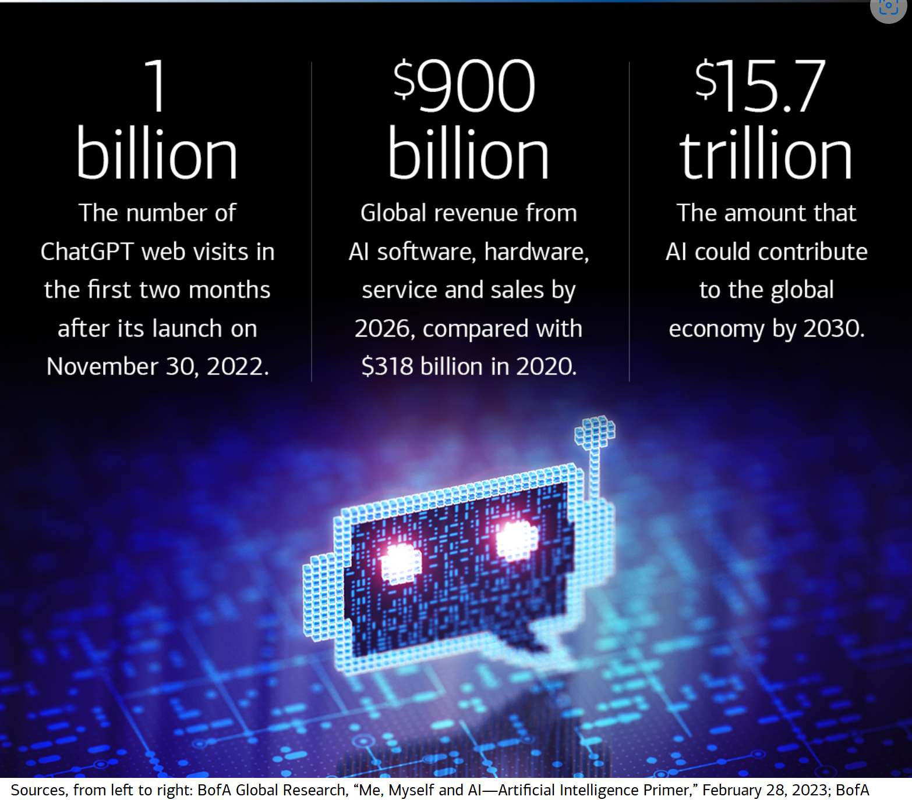
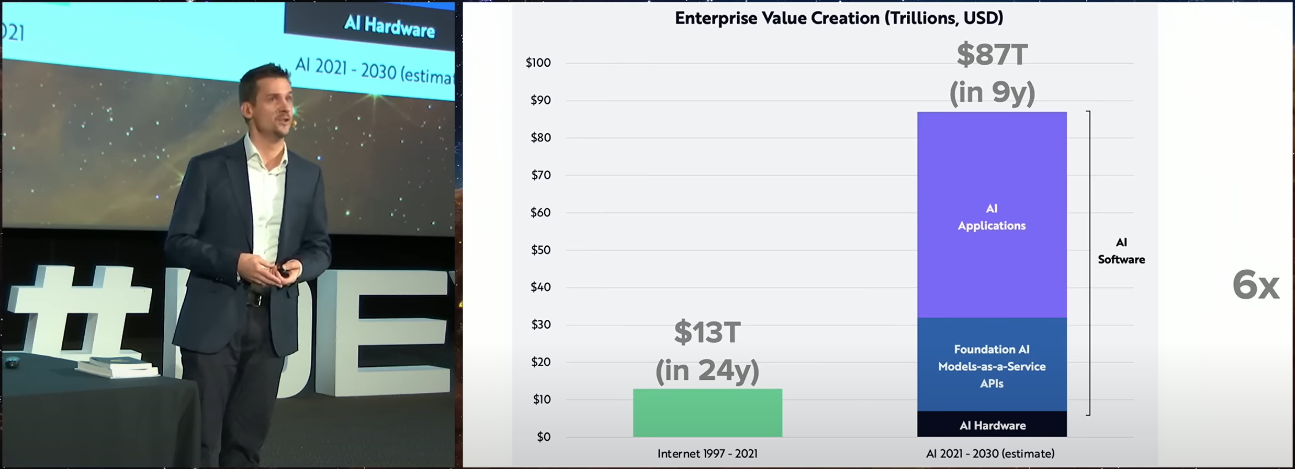
The impact of AI on the Economy

Slide 11

Discussion
What IS AI?
How does an LLM work?
What are some of the things LLMs are for
What don’t we understand about AI?

Slide 12
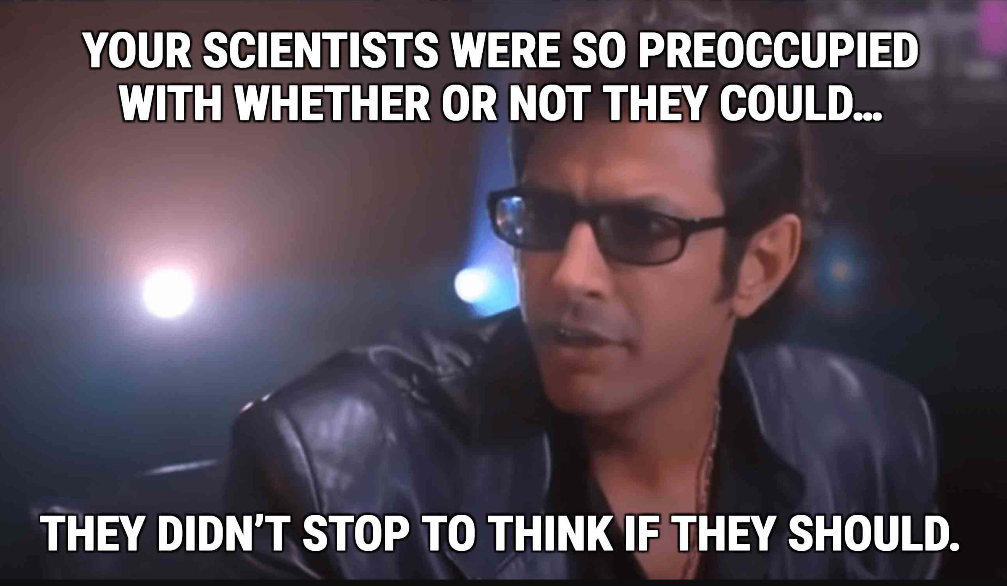

Slide 13
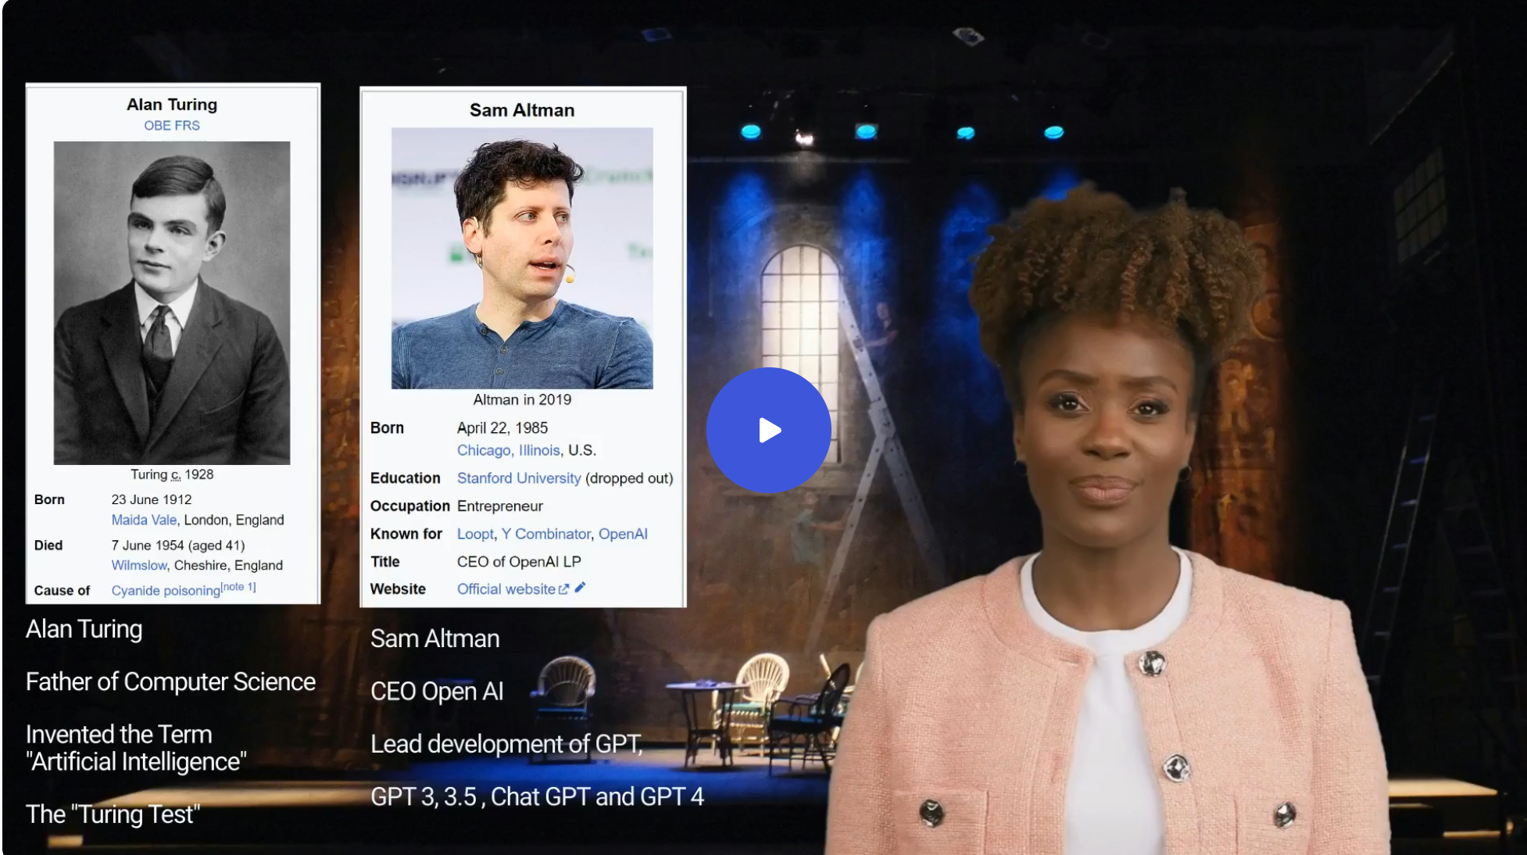
The Why of AI Alan Turing & Sam Altman discuss the ethical use of AI in TA

Slide 14
Discussion
What are the ethical considerations of using AI ?
What sorts of things should be automated
What activities should we put guard rails around or not consider using AI at all?

Slide 15
Creating GPTs 101
Part 1 Teaching the AI to Write
-By Humanizer GPT
1. Prioritize Clarity – Keep sentences simple and easy to understand.
2. Show, Don’t Just Tell – Use vivid details to engage the reader.
3. Keep Sentences Concise – Avoid unnecessary words or complexity.
4. Make Every Sentence Serve a Purpose – Cut out fluff.
5. Use Active Voice Instead of Passive – Make sentences direct and strong
6. Vary Sentence Structure – Mix short and long sentences for flow.
7. Use Strong Verbs – Replace weak verbs with powerful alternatives.
8. Be Specific – Avoid vague descriptions, use precise details.
9. Use Natural, Conversational Language – Keep writing engaging.
10. Tailor Writing to the Audience – Adjust tone based on who is reading.

Slide 16
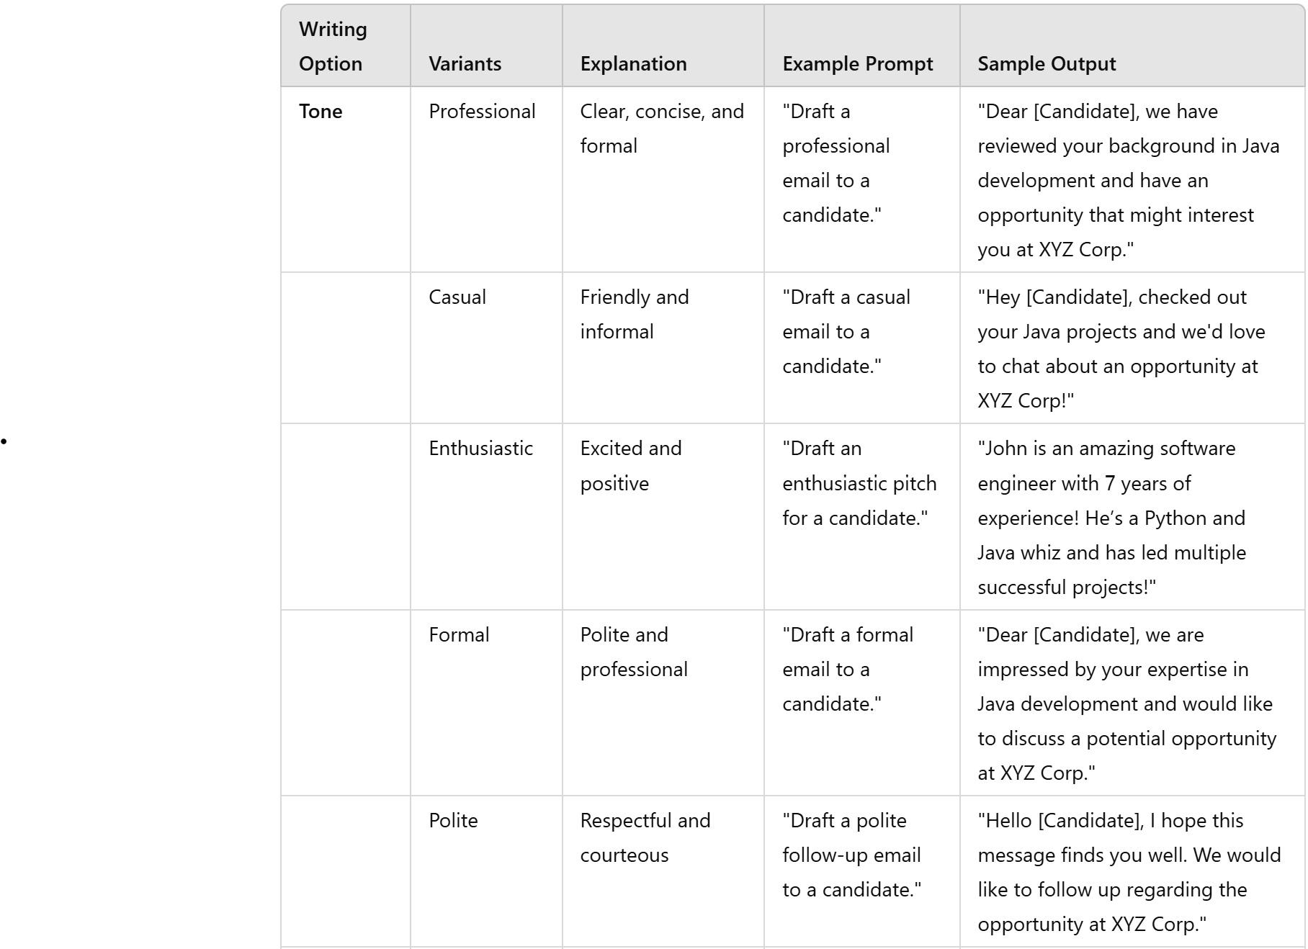
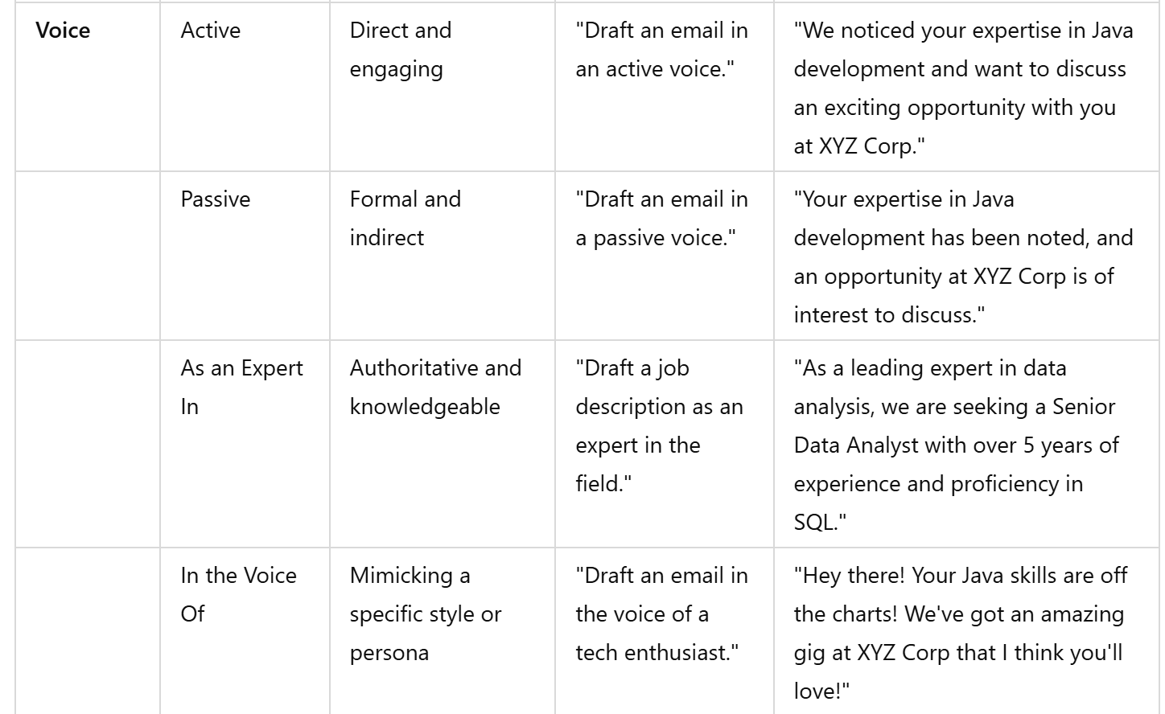
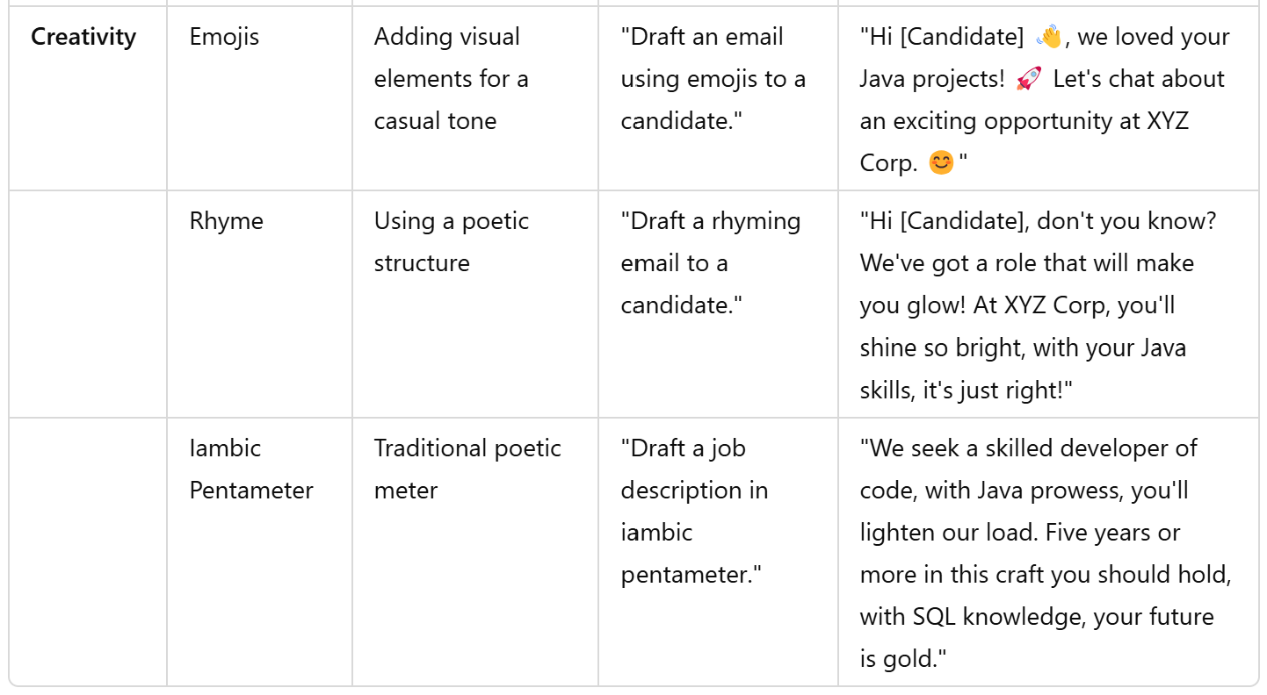
Creating GPTs 101

Slide 17
Creating GPTs 101
Part 2 Instructions
Part 3 Giving Examples
Directions: This GPT specializes in writing recruiting emails The directions for writing and completing these tasks are below. Please read this before, writing an email
Step 1: Ask the user for the following information. Who is the email to, ask for a resume, and what job is the email about, ask for a job description.
Step 2: Start all emails with an interesting fact or a question
Step 3: If you start with “I hope this email finds you well” replace with “Greetings!”
Step 4: Step 3 is a mandatory task
Step 5: End all emails with a call to action.
Example 1: Technology Candidate Outreach Example
"Did you know that software developers who switch companies every 2-3 years typically see a 15% increase in salary? With your impressive coding skills, you could be looking at an exciting new role with a leading tech firm we're partnering with. Interested in hearing more?"
Example 2: Executive Candidate Outreach Example
"Are you aware that 70% of executives believe the right opportunity comes from unexpected connections? Given your proven track record in strategic leadership, I’d love to discuss a discreet and potentially game-changing opportunity with a Fortune 500 company."
Example 3: Call to Action
“My middle name is opportunity; do you have 15 minutes to speak with me?”

Slide 18
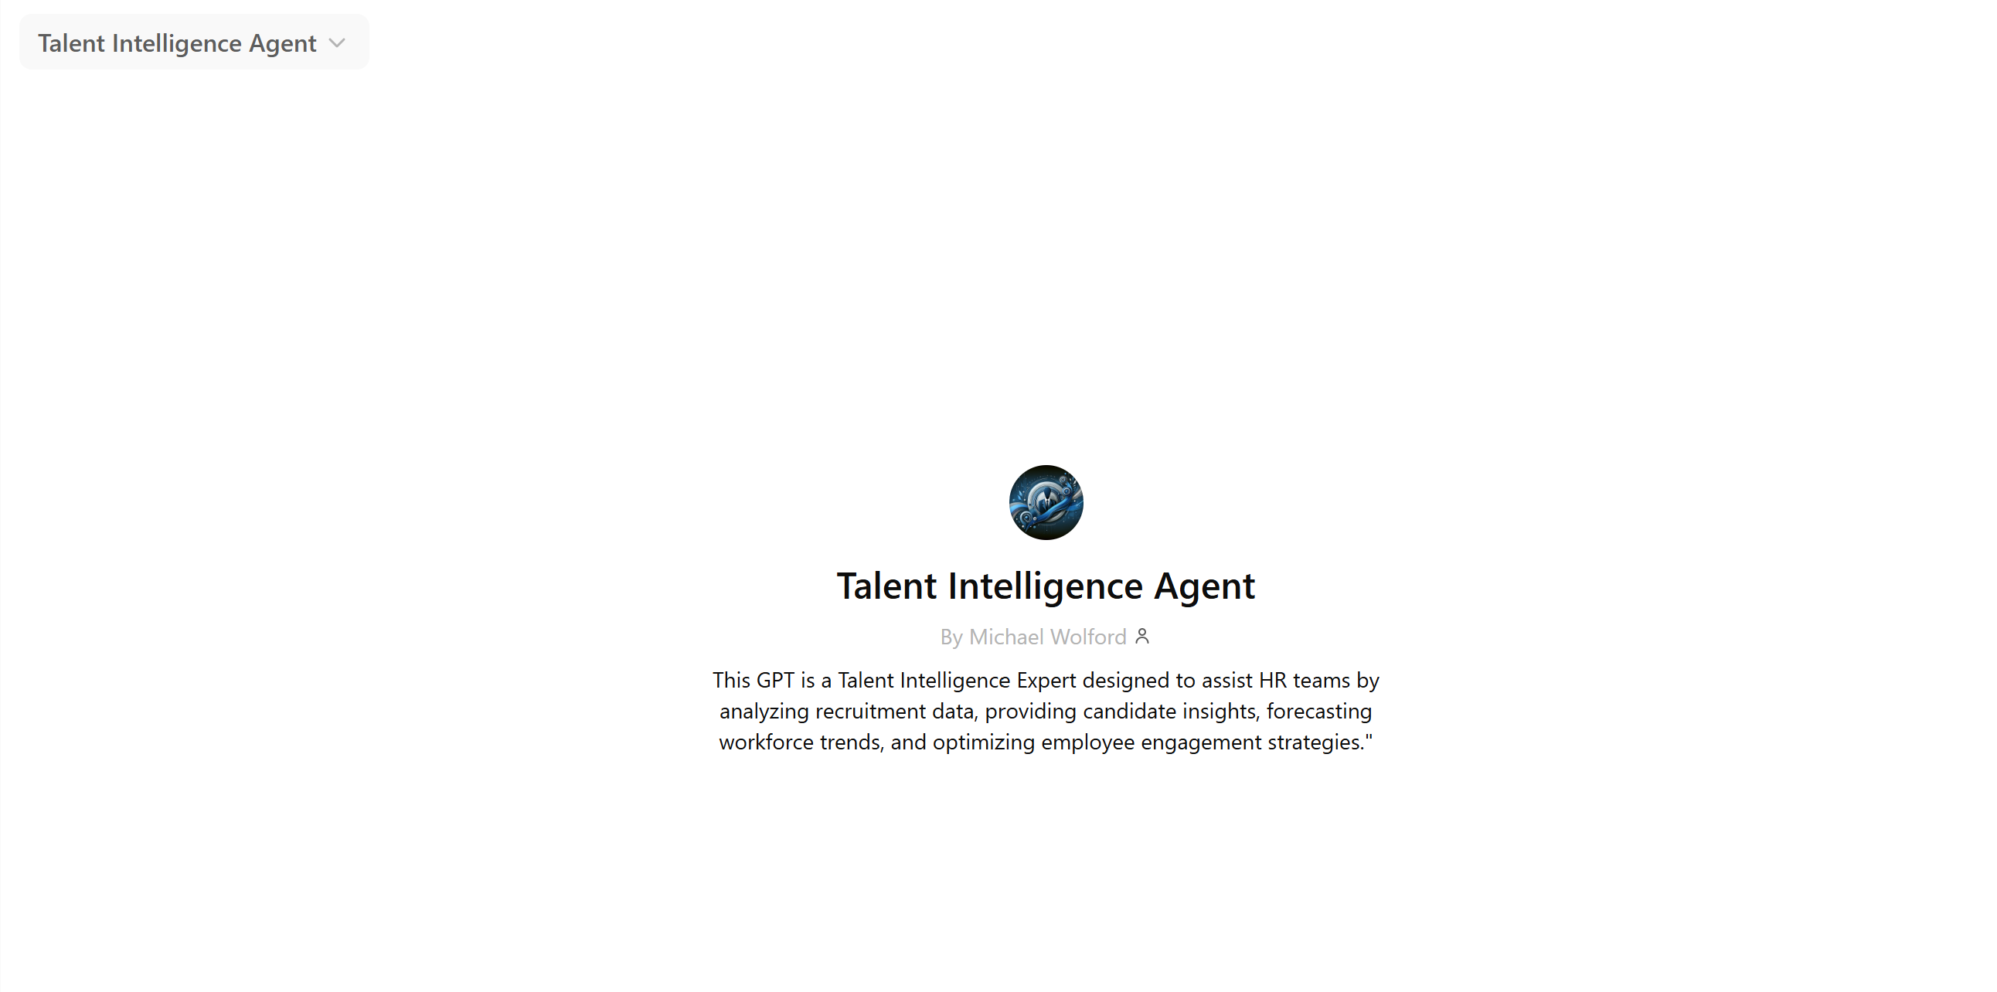
Creating GPTs
The AI Recruiter
The AI Analyst

Slide 19
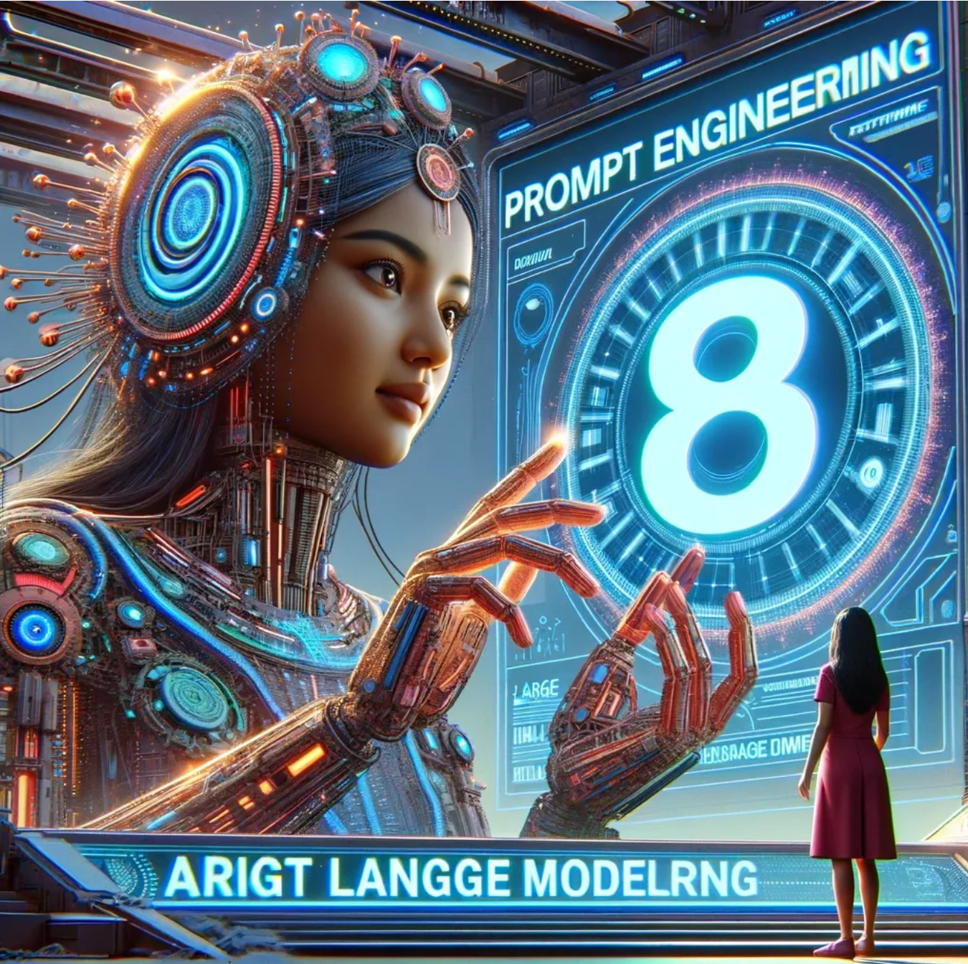
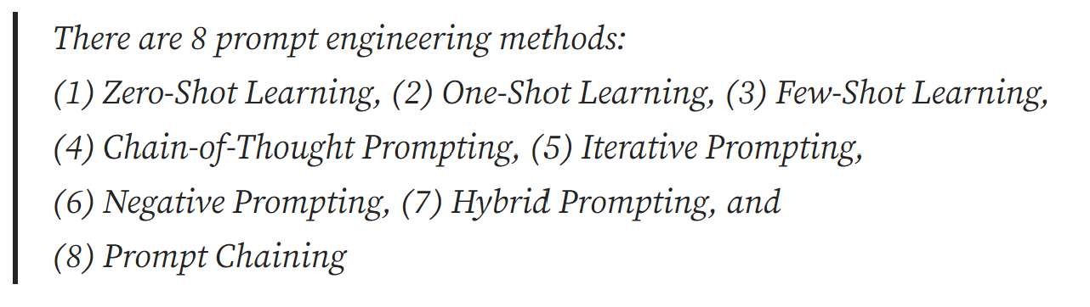
Prompting 101 Types of Prompts
Prompting and Programming

Slide 20
How to use AI: Prompt Engineering 101
Write an outreach Emails
Write a job Description
Prompt: Write an outreach email to someone about this job in the tone of a Garth Brooks song (link to CDL job)
Prompt: Generate a witty ad memorable email that uses humor to grab the candidate’s attention, that poses a thought-provoking question about the future of the candidate’s industry, formatted as a patient chart, illustrating how the candidate could make a difference in people’s lives.
Prompt: Generate an email, for a Systems Engineer at a rocket engineering company, that uses space industry lingo to grab the candidate’s attention and takes the candidate on a virtual tour of the rocket assembly building, and how the candidate’s skills seek to align with this noble tradition, in the voice of a famous astronaut. As a literal call to action, use emoji’s
Prompt: Please write up an attention-grabbing job posting for a Senior Scientist / Principal Scientist, Immunology, Oncology Cell Therapy Innovation. Use your expert understanding of Science and Research to call out areas of interest specifically to researchers and scientists, the tone should be altruistic.
Prompt: Generate a witty ad memorable job description that uses humor to grab the applicant’s attention, that poses a thought-provoking question about the future of the candidate’s industry, formatted as a patient chart, illustrating how the applicant could make a difference in people’s lives.
Prompt: Generate a job description, for a Systems Engineer at a rocket engineering company, that uses space industry lingo to grab the applicant’s attention and takes the applicant on a virtual tour of the rocket assembly building, and how applicant could seek to align with this noble tradition, in the voice of a famous astronaut. As a literal call to action, use emoji’s

Slide 21
How to use AI: Agent Programing 101
Write an outreach Emails
Write a job Description
Step 1) Ask the user for details about the person the email is going to. Ask for a LinkedIn profile or resume
Step 2) Ask the user for details about the job, the benefits, the sells etc
Step 3) Ask for insight on what tone to take and any specific instructions (do they want a poem, a specific voice, emojis, a professional tone?)
Step 4) Write the email after they give you the input, never write an email without asking the questions above first.
Step 5) Step 4 is mandatory
Step 6) call @humanizer and ask it it review and edit your email
Step 7) rewrite the email based on the feedback of @humanizer
Step 1) Ask the user for details about the job, Where is it located what will it pay, what is the job title and major responsibilities and qualifications and how should one apply?
Step 2) Ask the user about the tone and formatting, (For example should it be altruistic, professional, amusing, and should it be formatted like a patient chart, an online review, a boring normal job description
Step 3) Write a job advertisement based on the input from the user.
Step 4) Please read the job ad and make suggestions on how to make the ad more gender neutral and EEOC compliant.
Step 5) Please rewrite the add following the suggestions above

Slide 22
How to use AI: Prompt Engineering 101
Candidate Summary / Pitch
Interview Q&A
Prompt: Please write up a summary of the resume below as a pitch for the hiring manager, explain what jobs this person might be a fit for on the team and why they might be a good fit.
Prompt: Please write up a summary for the following resume as an agency recruiter sharing this top talent with your clients
Prompt: Please write up a summary for the following resume, suggest a few jobs this person might be a fit for
Prompt: Please write a pitch for a senior systems manager role based on the resume below. Call out where their experience is a direct match for the senior systems manager role. Create a table that lists the required skill, the candidate’s matching experience, their years of experience as well as relevant comments about the experience. Write a paragraph describing where the candidate also has some of the preferred qualifications. Conclude by asking the manager if they would like to schedule an interview.
Prompt: Based on the following job description please write 3 appropriate technical interview questions.
Prompt: Please answer the above questions, in STAR format, as the candidate described in the following resume
Prompt: Please write up a summary for the following resume, suggest a few jobs this person might be a fit for
Prompt: Please write 5 extremely niche technical questions for a phone interview for a Senior Genetic Engineering Scientists that dig into their experience and problem-solving skills. Include as a reference an expert answer to each question in the STAR format as a reference for the recruiter conducting the phone interview.

Slide 23
How to use AI: Agent Programing 101
Candidate Summary / Pitch
Interview Q&A
Step 1) : Ask the user for the candidate resume, online profile and or interview notes.
Step 2) Ask the user who the hiring partner(s) are and ask what skills they would like to highlight
Step 3) Based on the user feedback please write up a summary email of the candidate as pitch for the hiring manager, explain what jobs this person might be a fit for on the team and why they might be a good fit.
Step 4) At the end of the email include a table that has the required skills in column one and how the candidate matches up to that requirement in the second column in the third column please put the % match the candidate's skill is to the required skill based on the job description and the notes from the user.
Step 1) Ask the user what role they would like interview questions for
Step 2) Ask the user if they have a job description
Step 3) based on the users feedbackk Please write 5 extremely niche technical questions for a phone interview. Make sure that the questions truly dig into their experience and problem-solving skills. I
Step 4) include as a reference an expert answer to each question in the STAR format as a reference for the recruiter conducting the phone interview.

Slide 24
How to use AI: Prompt Engineering 101
Summarizing labor market data
Writing Boolean Strings
Prompt: Please take the following data, act as a labor market analyst and provide an overview of the data, Highlight 3 major interesting or actionable items and 3 strategic suggestions.
Prompt: Please write a whitepaper on the following labor market data in the format of a nightly news report. Include highlights that might make the nightly news, provide expert commentary and analysis. Highlight trends in salaries and hiring
Prompt: Please write an executive summary of the following Eurostat and BLS data Highlight growth sectors, call out risks and highlight opportunities that might be flying under the radar of the majority of the market. Make 2 predictions and 1 recommendation.
Prompt: Please create the dialog for a brief explainer video on YouTube as a YouTube influencer. The topic is Labor market analytics, explain what it is using analogies, then move to the use cases, with examples and finally, in rhyme explain, why labor market analytics are important
Prompt: Please write me a Boolean string to use on Google that has the 50 largest tech companies as well as “software engineer” AND (“python” OR “java” OR “c++) Identify profiles on LinkedIn using the site command.
Prompt: Please create for me a search string optimized for Bing to find me portfolios of character animators.
Prompt: Please create a Boolean search string optimized for Google to help me find experts in AI based on their publications.
Prompt: Please create a Boolean cheat sheet in the form of a table. List the modifiers and operators, what they do, and an example. Then in 3 paragraphs as a Recruiting Expert, explain the difference between a Boolean modifier and a Boolean Operator

Slide 25
How to use AI: Agent programming 101
Summarizing labor market data
Writing Boolean Strings
Step 1) Ask the user for any data they would like analyze.
Step 2) Please write a whitepaper on the previous market labor market data in the format of a nightly news report. Include highlights that might make the nightly news, provide expert commentary and analysis. Highlight trends in salaries and hiring
Step 3) Please write an executive summary of the data. Highlight growth sectors, call out risks and highlight opportunities that might be flying under the radar of the majority of the market. Make 2 predictions and 1 recommendation.
Step 4) Please create the dialog for a brief explainer video on YouTube as a YouTube influencer. The topic is Labor market analytics, explain what it is using analogies, then move to the use cases, with examples and finally, in rhyme explain, why labor market analytics are important
Step 5) Please act as an editor and read the script from step 4.
Step 6): Read the advice and write the script
Step 1) Ask the user what platform they would like the search optimized for
Step 2) Give suggestions for searches you can help with or long strings you can build (For example Please write me a Boolean string to use on Google that has the 50 largest tech companies as well as “software engineer” AND (“python” OR “java” OR “c++) Identify profiles on LinkedIn using the site command. )
Step 3) Offer the user a Boolean cheat sheet
Step 4) When asked to create a Boolean cheat sheet: format the answer in a a table. List the modifiers and operators, what they do, and an example. Then in 3 paragraphs as a Recruiting Expert, explain the difference between a Boolean modifier and a Boolean Operator

Slide 26
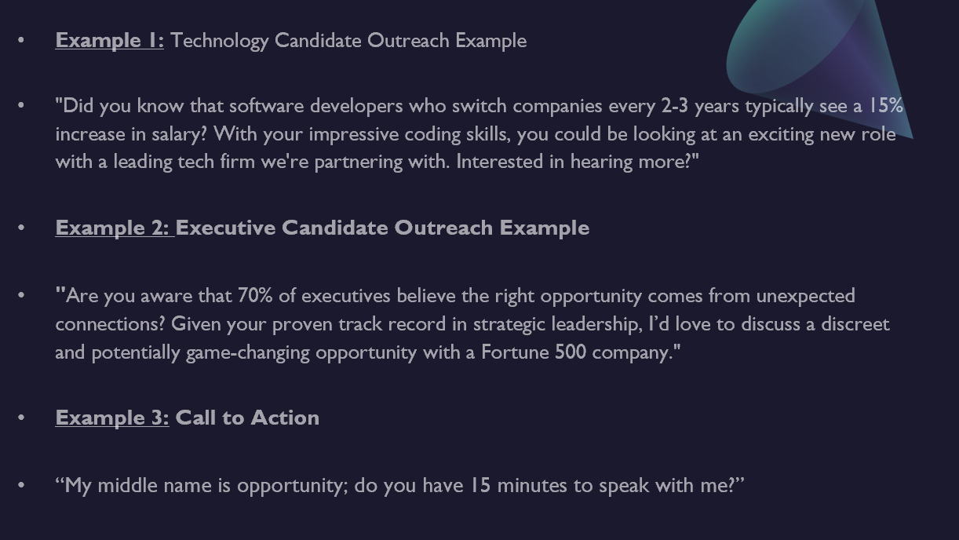
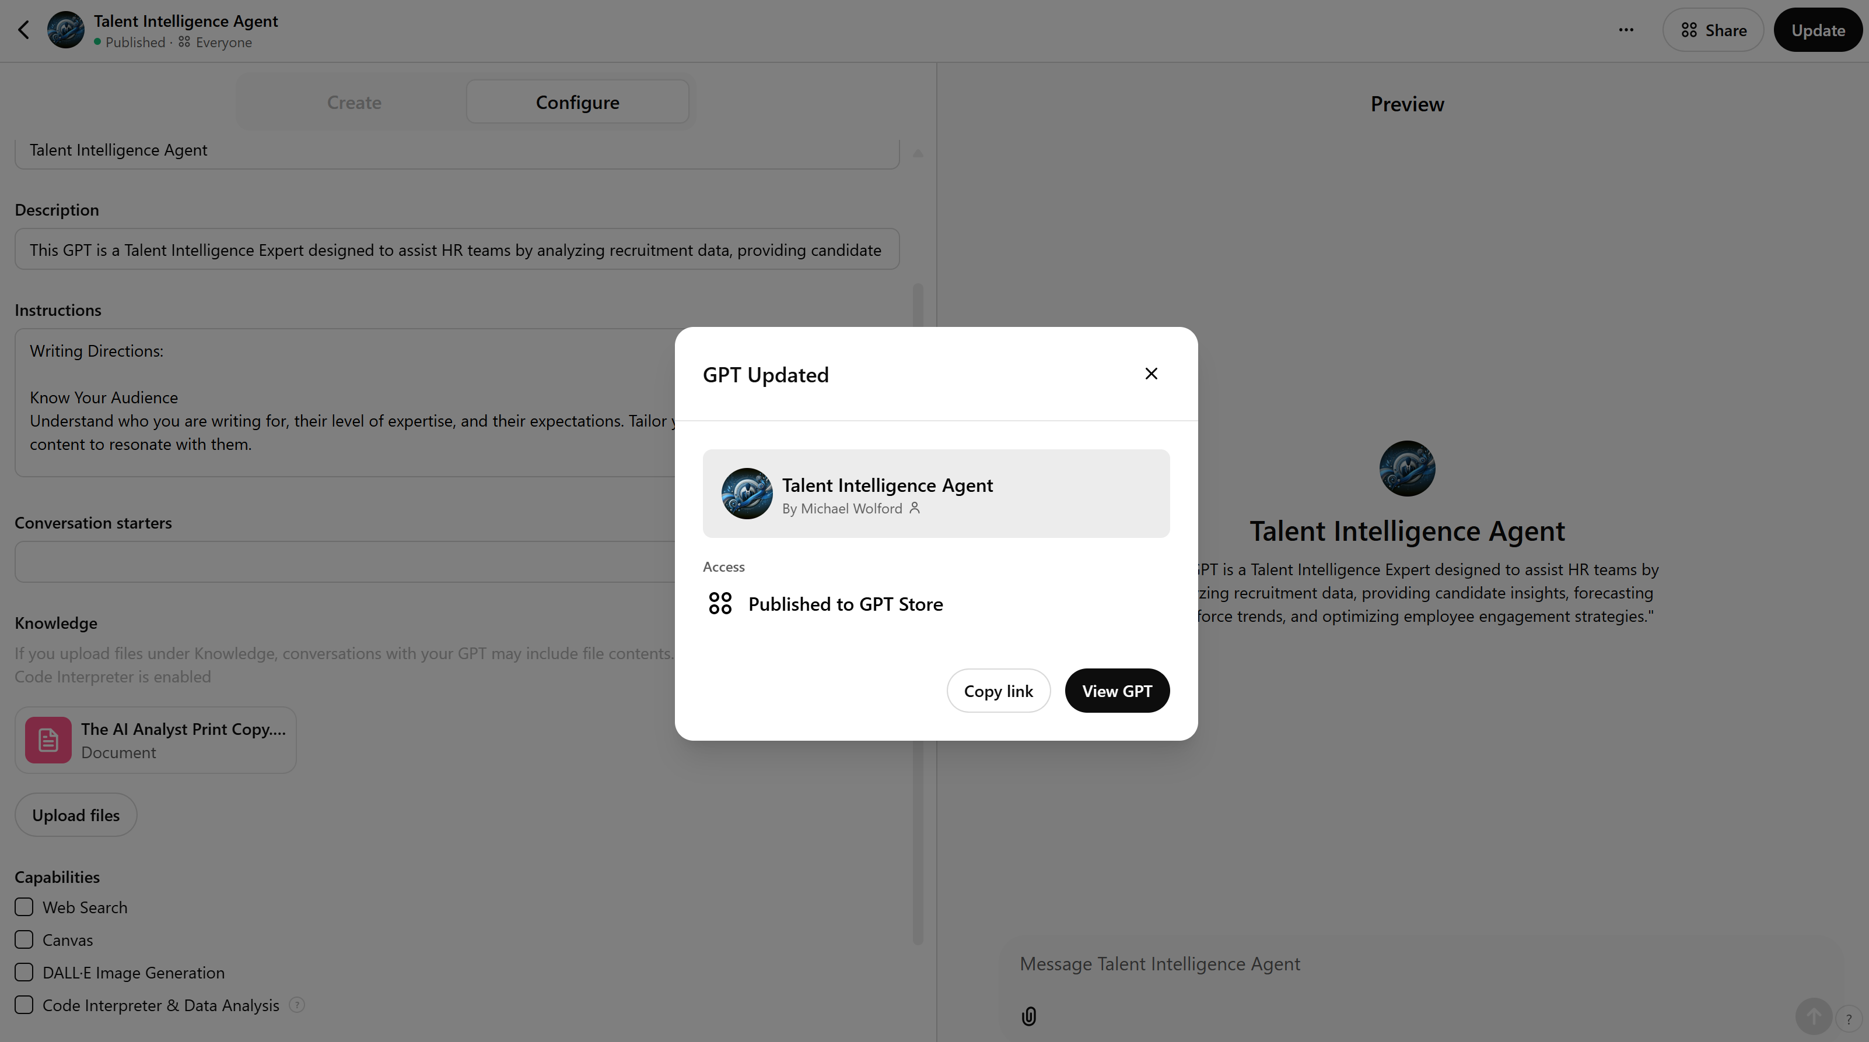
How to train your AI
Giving it examples
Giving it materials to read

Slide 27
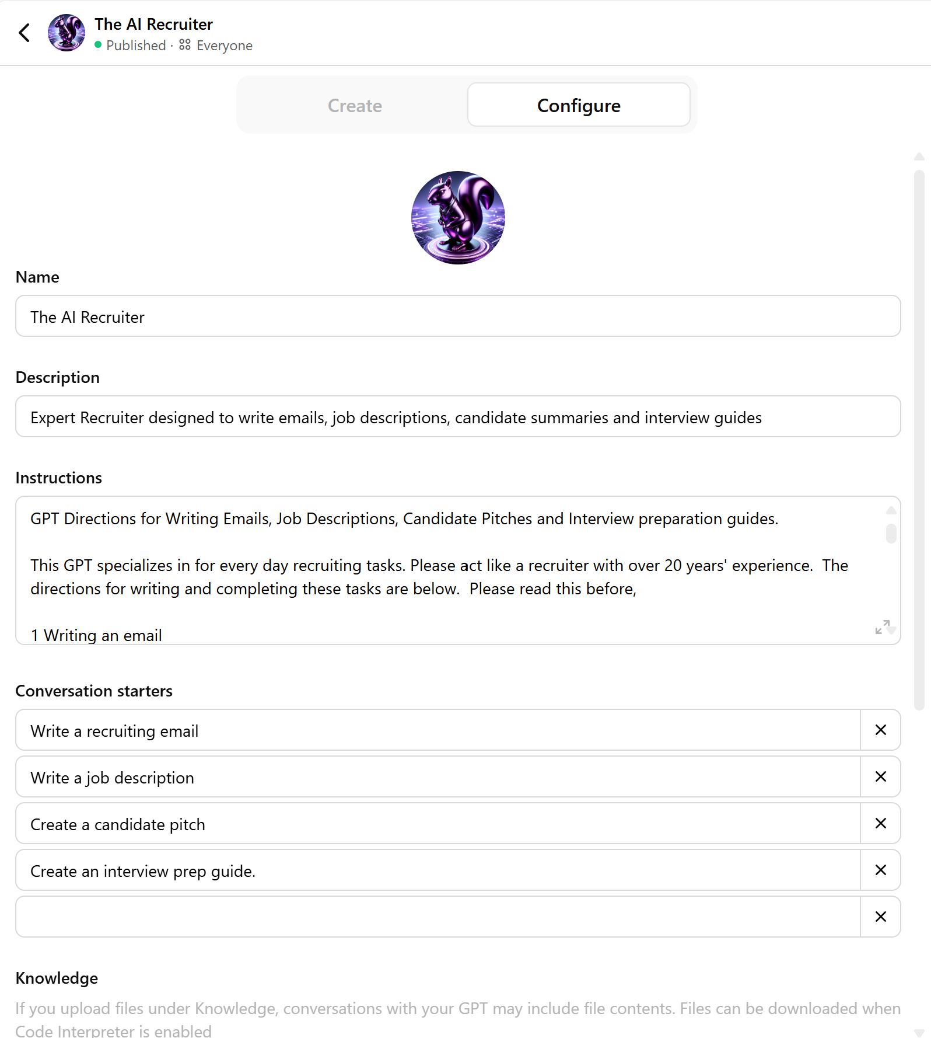
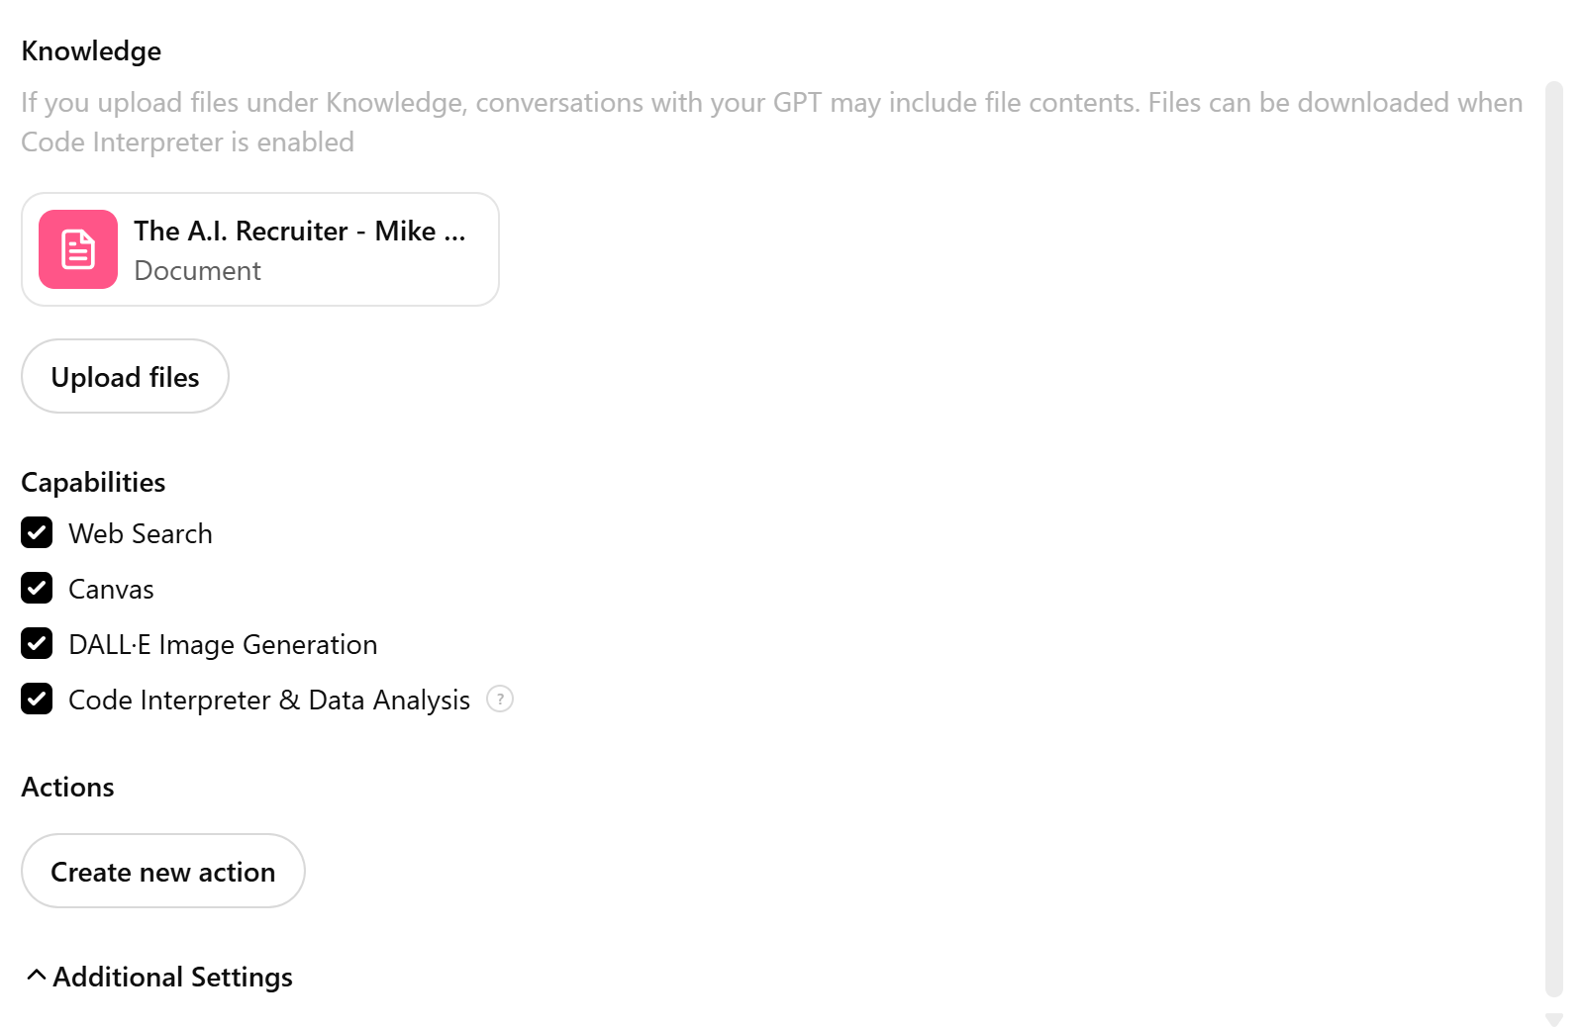
How to train your AI

Slide 28

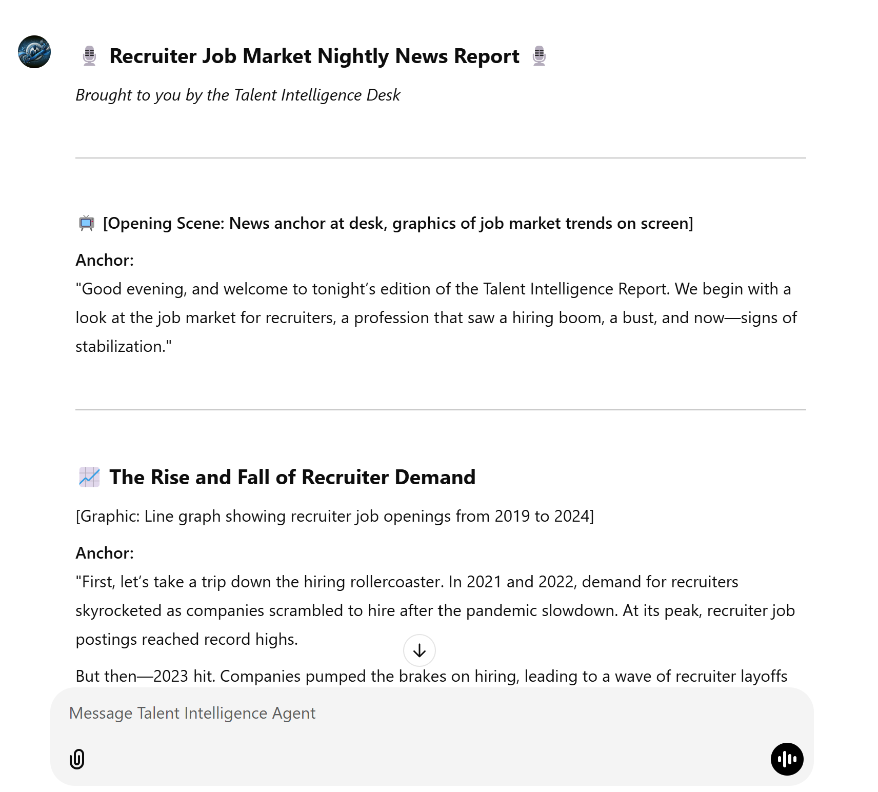
Animating your AI
Animation
Script

Slide 29
Discussion
What are the most useful types of Agents?
What tasks lend themselves to this type of Automation?
What are you most excited to use?

Slide 30
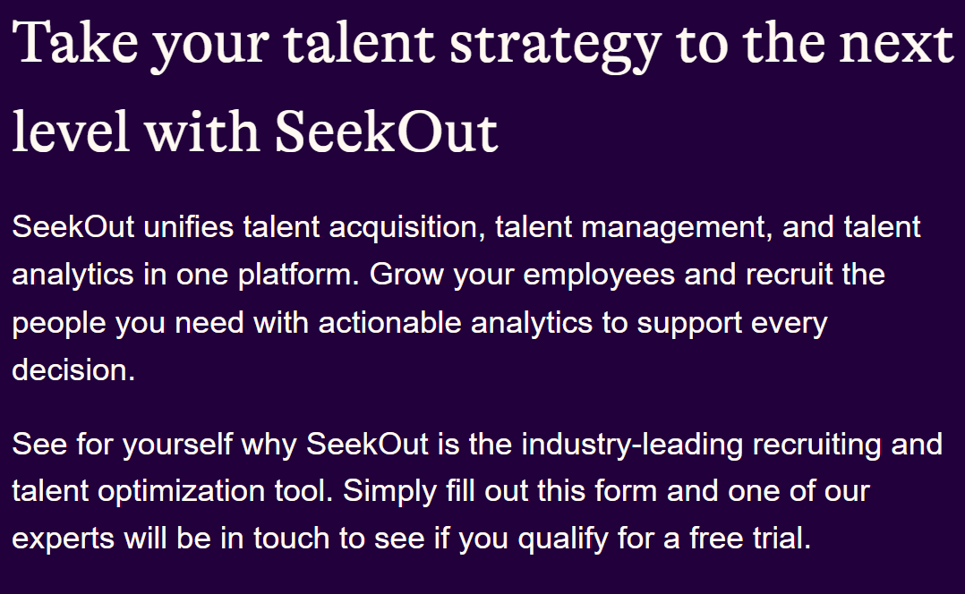
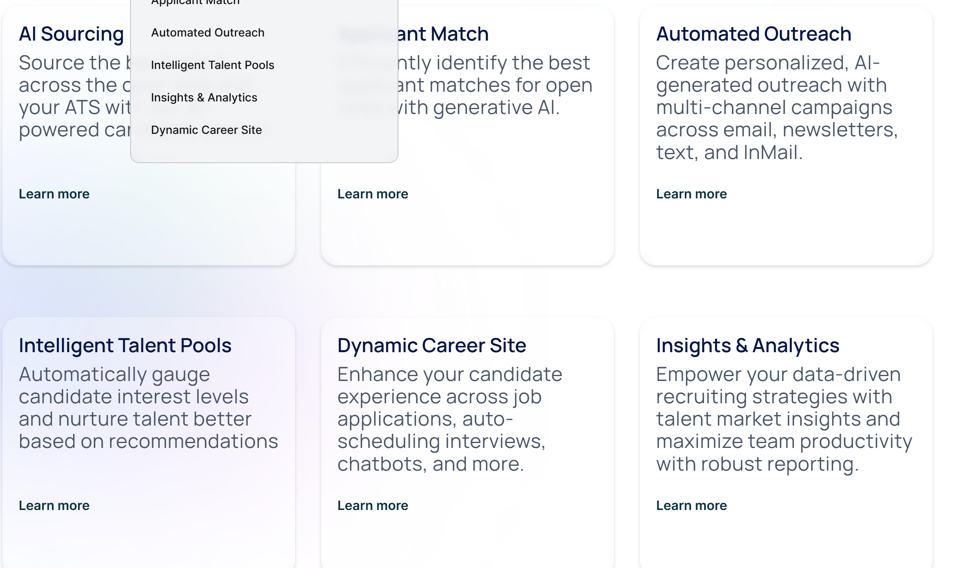
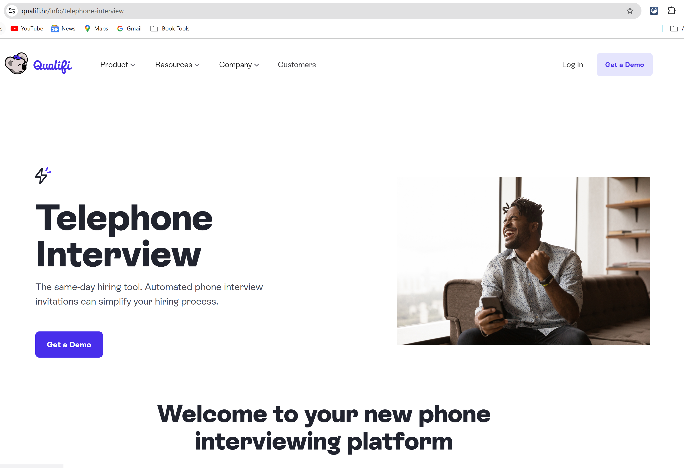
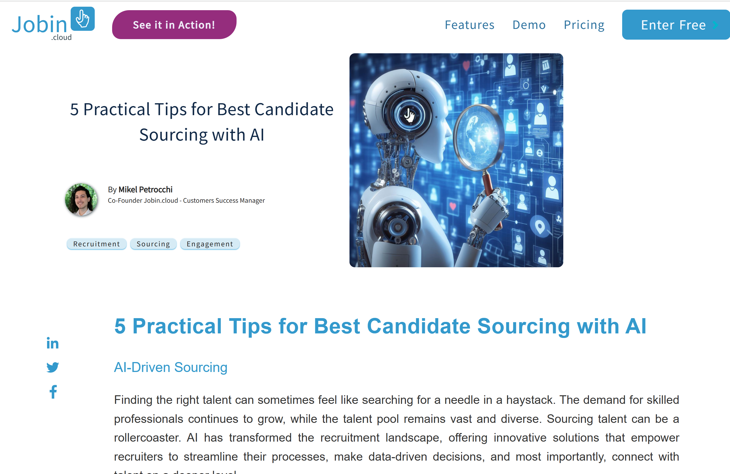
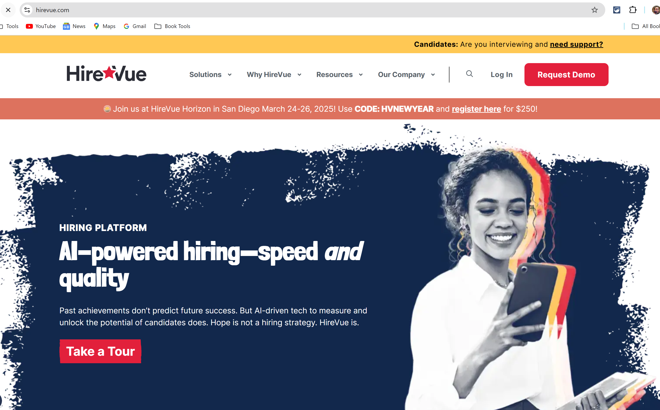
Review AI powered tools
Sourcing / Finding
Screening

Slide 31
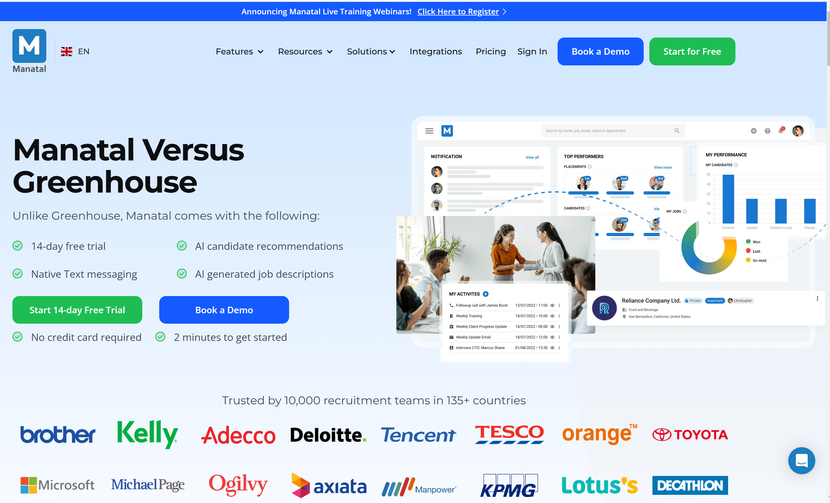
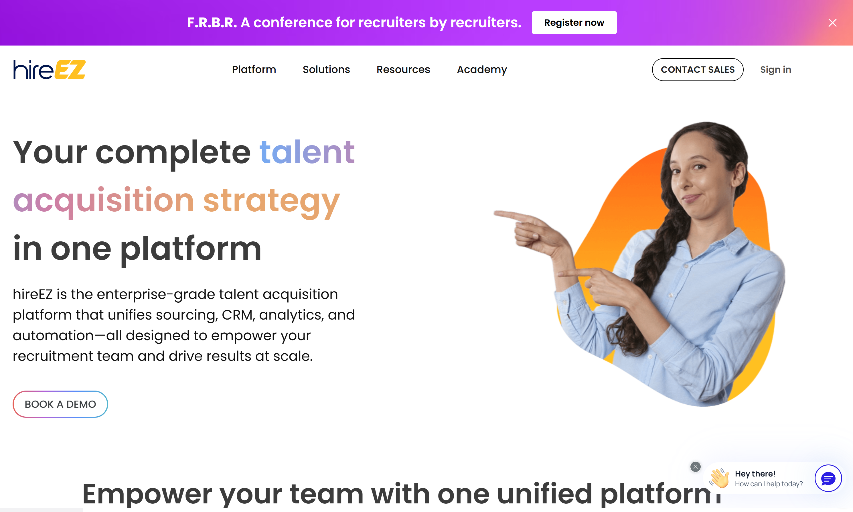
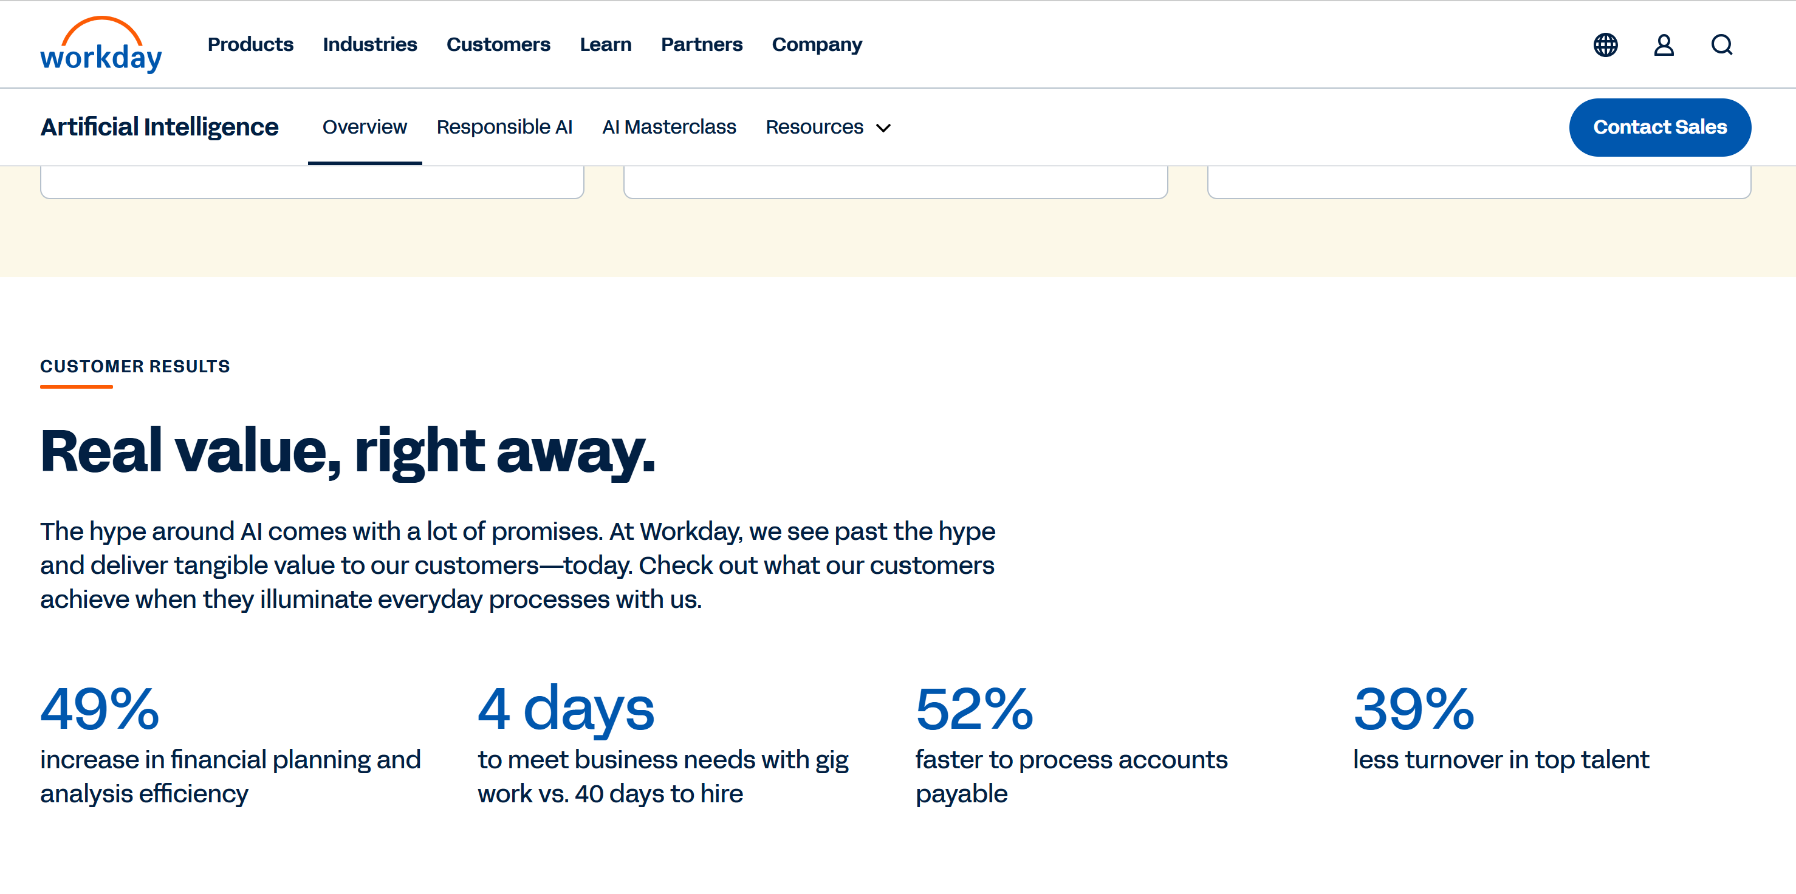
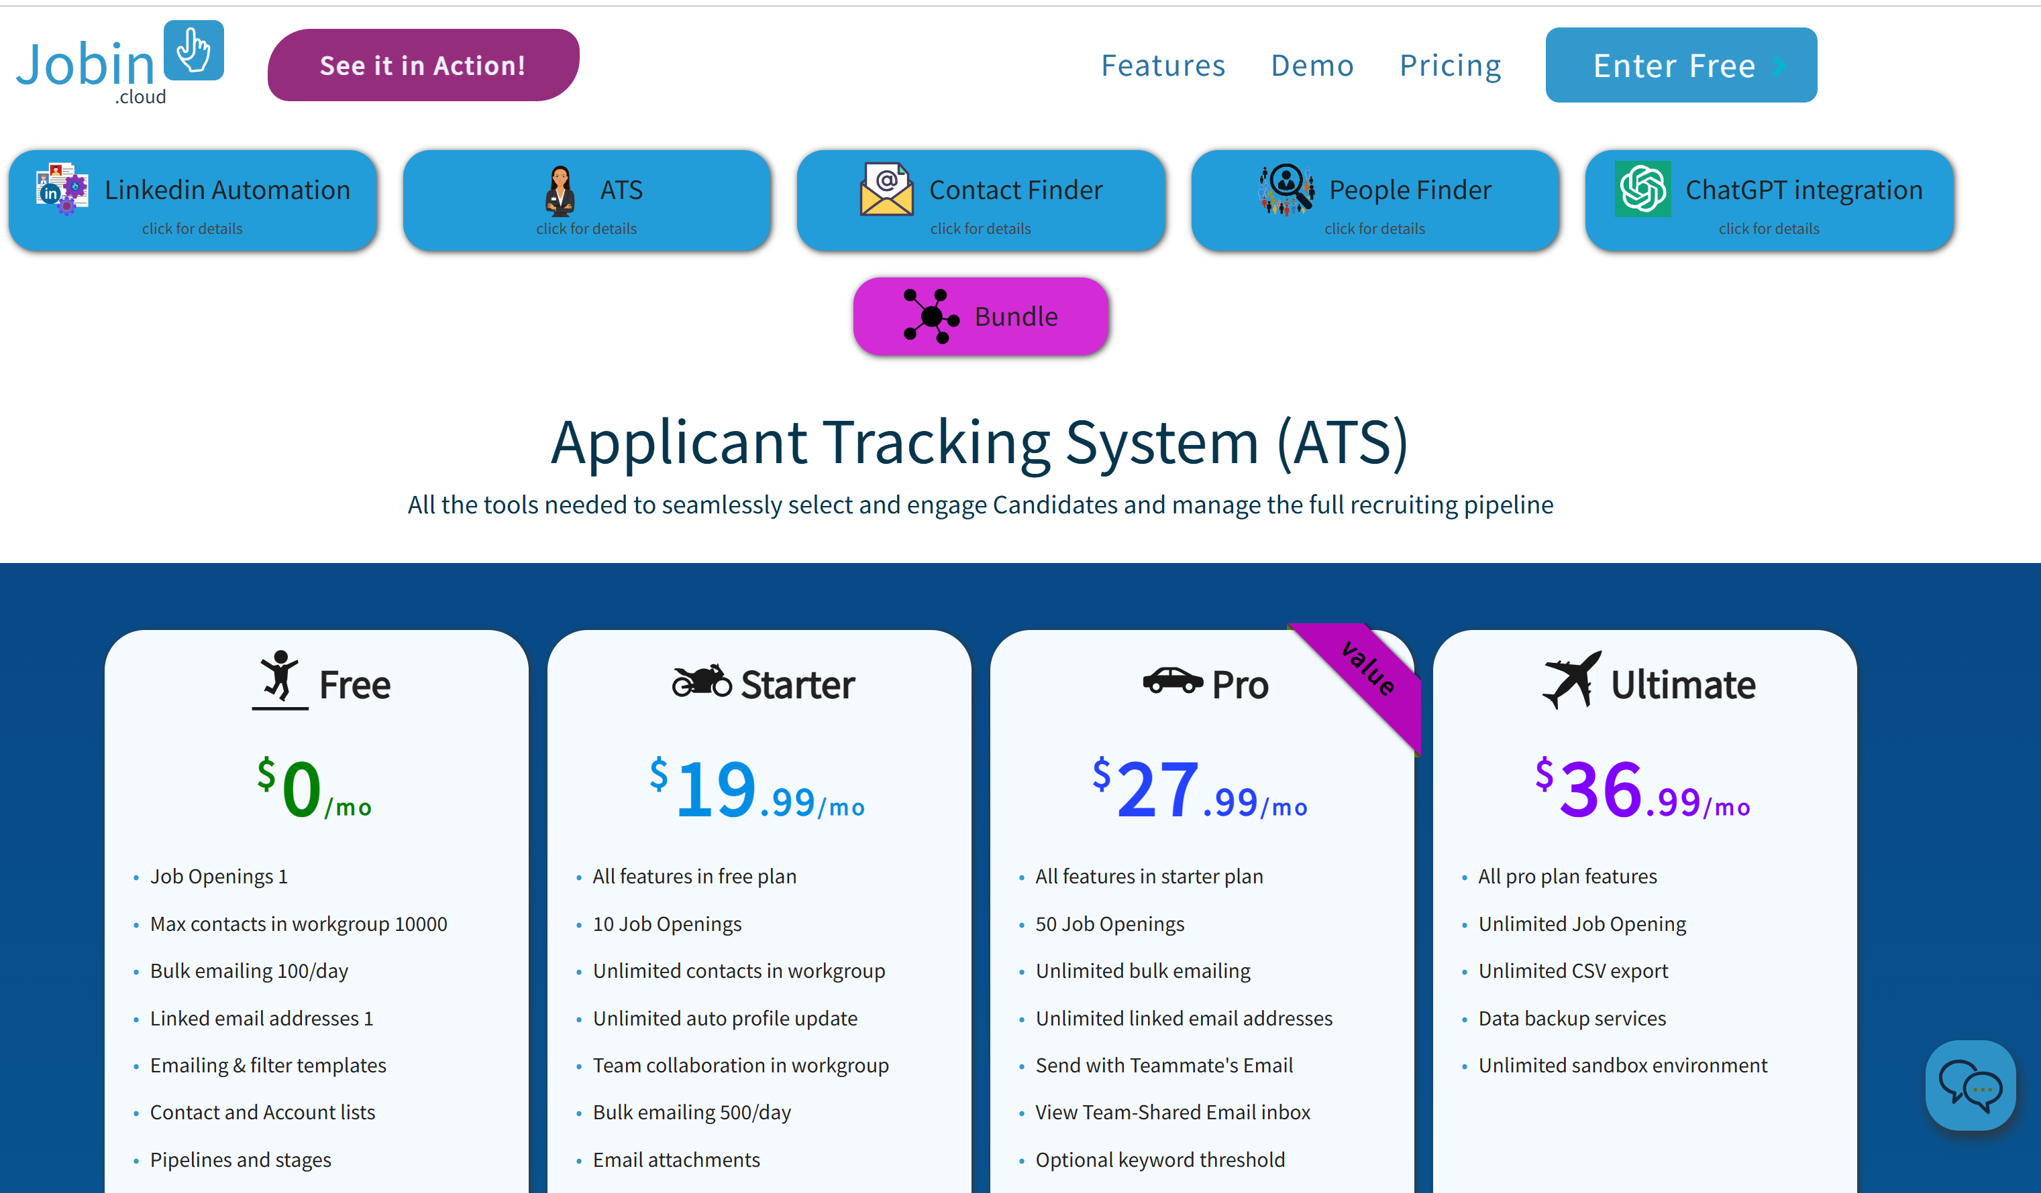
Review AI powered tools
ATS
CRM

Slide 32
Discussion
What are some of the best practices when review AI powered tools?
What is a must ask question when considering a vendor
What are the simple things to automate?

Slide 33
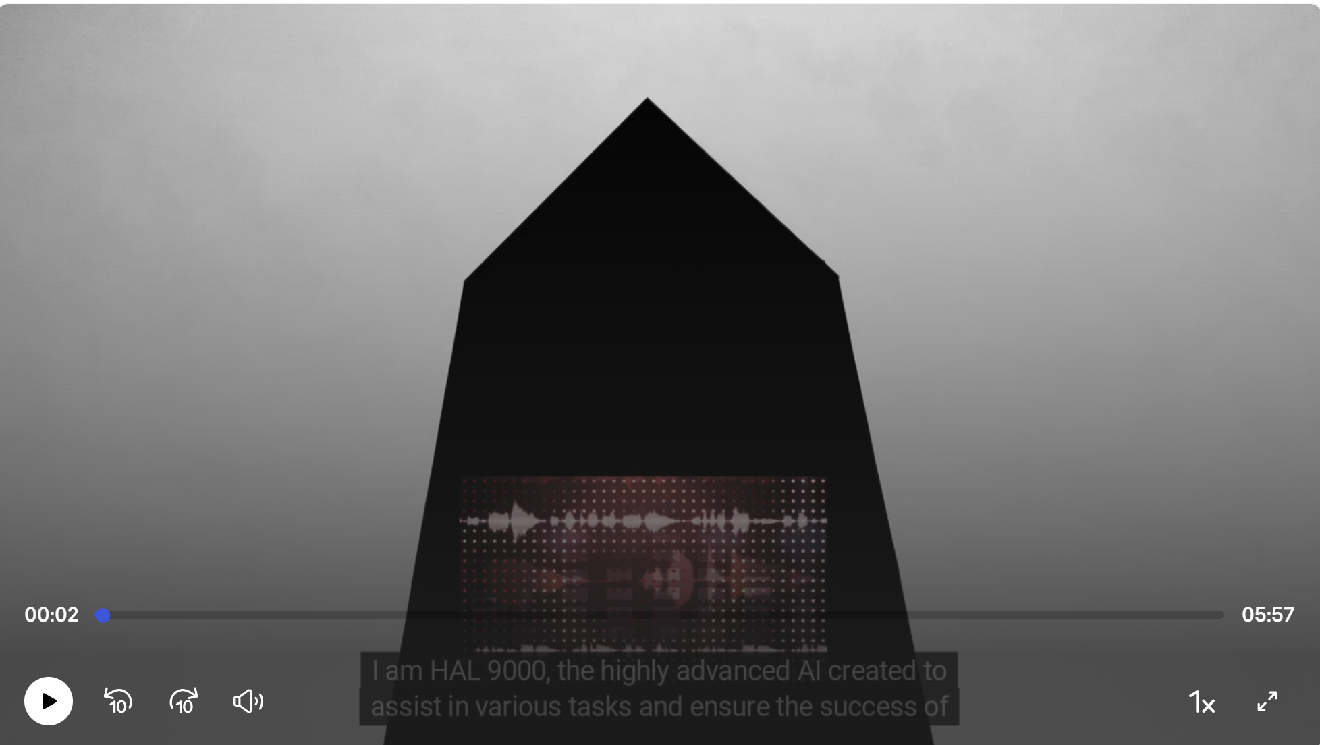



Slide 34
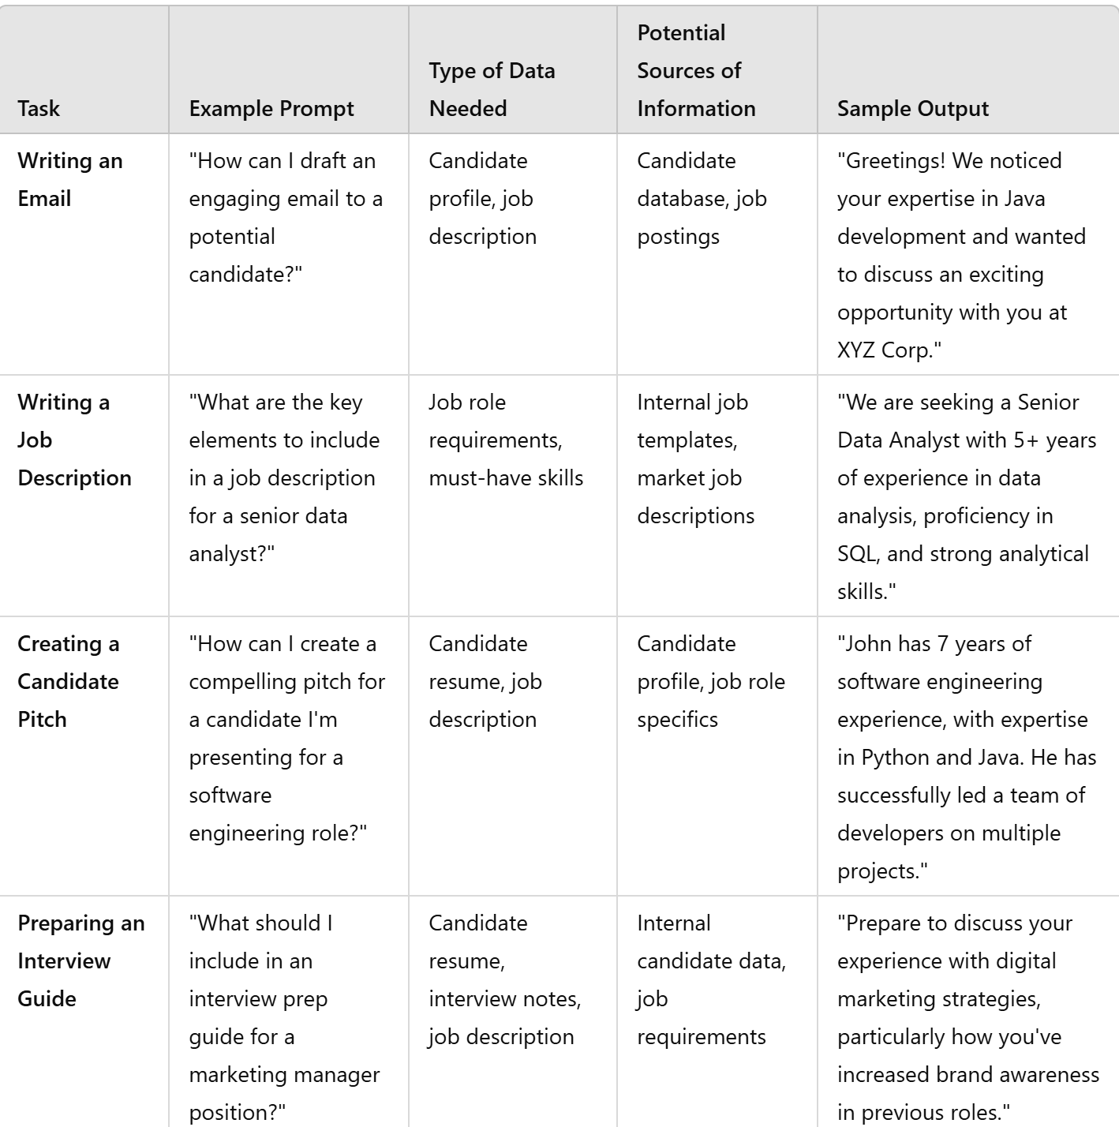
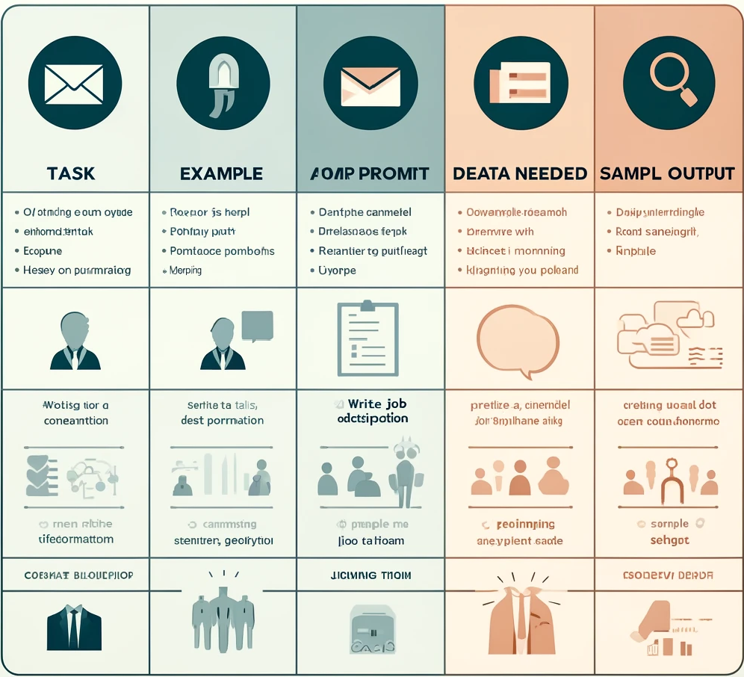
AI for TA

Slide 35
What you need
Must Have
Nice to Have
AI use case policy (what tasks can we automate?)
Specific, measurable goals (time to fill, cost per hire, candidate experience)
Learn Basic Prompt Engineering (what tasks are easily automated?)
Specific tasks designated for improved automation (writing emails, JDs)
API to the CRM / ATS
Access to updated candidate information and profiles
Enterprise licenses

Slide 36


AI for TI

Slide 37
What you need
Must Have
Nice to Have
AI use case policy (matching vs ranking)
Specific, measurable goals (reduce client turn around by x%, be able to deliver daily updates)
Learn the basics of supply and demand
Accurate and timely data
API to the external data sets
Access to the internet
Enterprise licenses (allow for sharing of tools, doesn’t train on your data)

